Slide 1
HTS Expansion at Pfizer: Integrated Automated Lab Systems
Rich Frisbie
On Behalf of the HTS Laboratory,
Part of Medicinal Sciences – Discovery Biology & Pharmacology
Pfizer Inc., Groton CT USA.
HighRes Biosolutions Exhibitor Tutorial, SLAS2026
February 10th, 2026

Slide 2
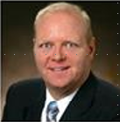
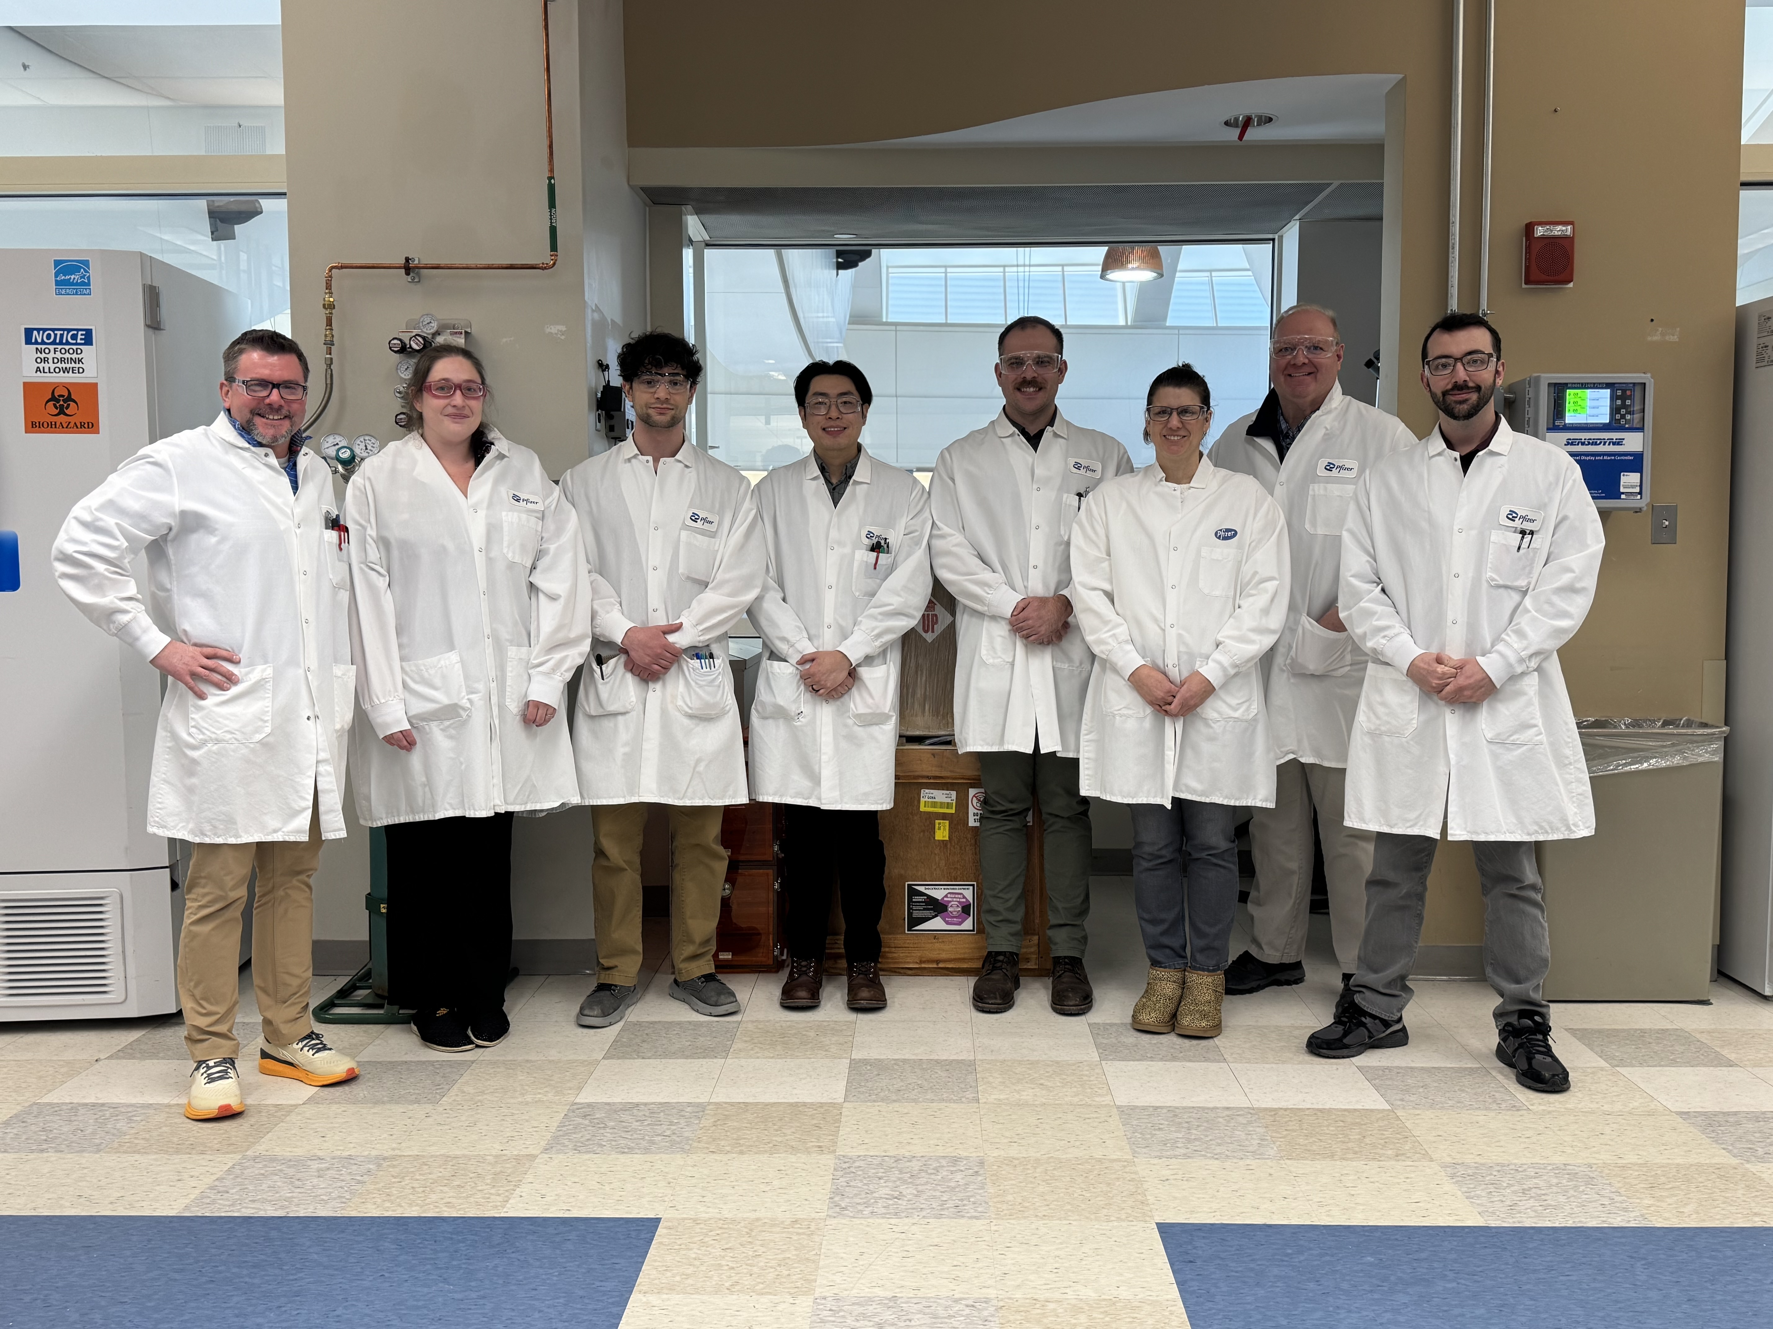
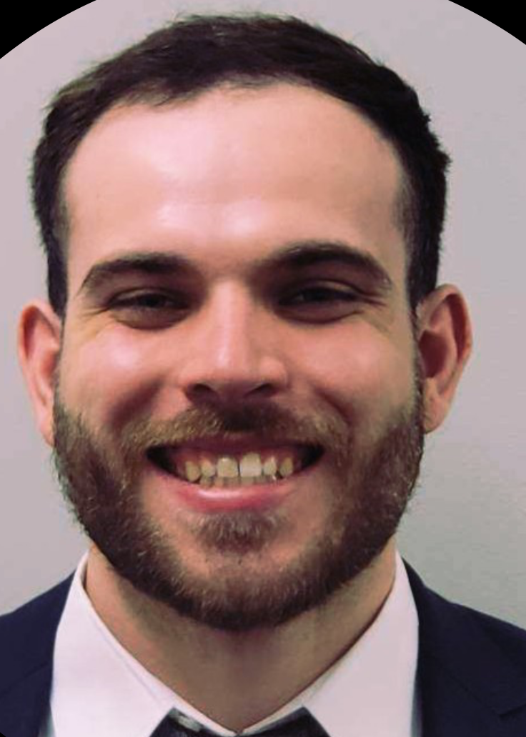
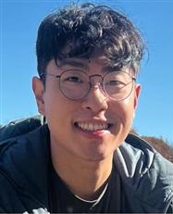
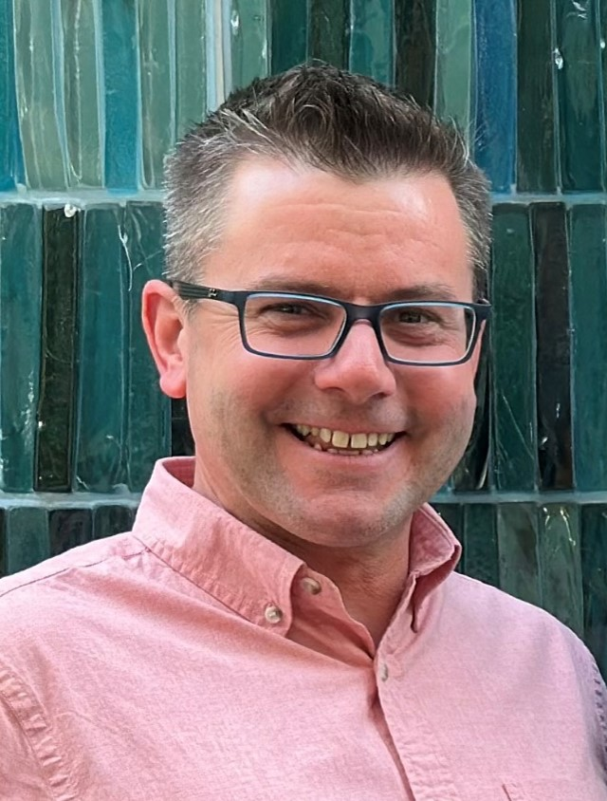
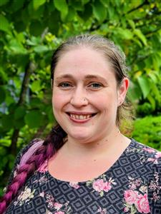
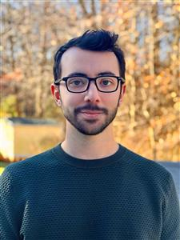
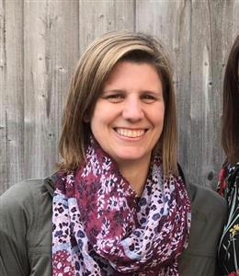
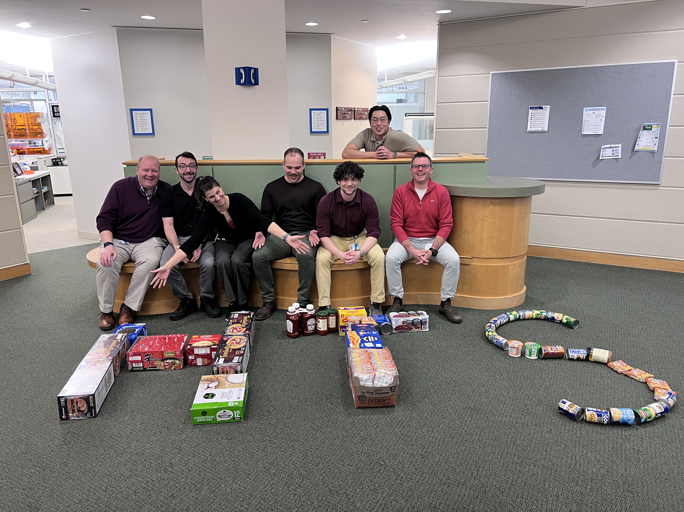
Discovery Biology & Pharmacology (DBP) –
High Throughput Screening (HTS) Team
Eric Johnson
HTS Lab Head
Jacob Bunch
Automation Engineer
Tony Chow
Automation / Data
Rich Frisbie
Automation / Data
Sarah Hyde
Data Analytics
Jeremy Schriener
Automation / Data
Lucy Stevens
A. Development / Data
Joe DiStefano
Contractor

Slide 3
Key Infrastructure & Design Considerations For HTS System Builds
Goal state of the art instrumentation & robotic automation:
Breadth of assay formats (technology, complexity)
Evaluation of prior Pfizer HTS screens
1536-well formats
Integration with existing equipment
Redundancy on common workflows
Modular design to enable flexibility
Flexibility to pivot to emerging technologies
EHS compliant
Location of space/feasibility
Infrastructure to support system and future expansion
Leverage new technologies
Faster, more efficient screening
Build our screening capacity
Today’s focus is on build of 3 new HighRes Systems in support of HTS

Slide 4
Key Deliverables & Timelines to HTS Build
Concepts and Design started back in early 2024
Quote to install, ~10 months
Production, 1-2 weeks post SAT
Design HTS HCS System
Installation/SAT of Z-Cell
Z-Cell / TRI-DOC Production
Design HTS
System(s), Z-Cell + Flex Cart
Installation/SAT HCS
HighRes FAT (Flex Cart)
S1 2024
S2 2024
S1 2025
S2 2025
S1 2026
Apr
HighRes FAT
(Z-Cell)
Installation/SAT of TRI-DOC/Flex Cart
Jul
Jan 2025
Jan 2026
Jul
Lab
Renovations
HighRes FAT (HCS) System
Design TRI-DOC
Full Production Screening
(All 3 systems)

Slide 5
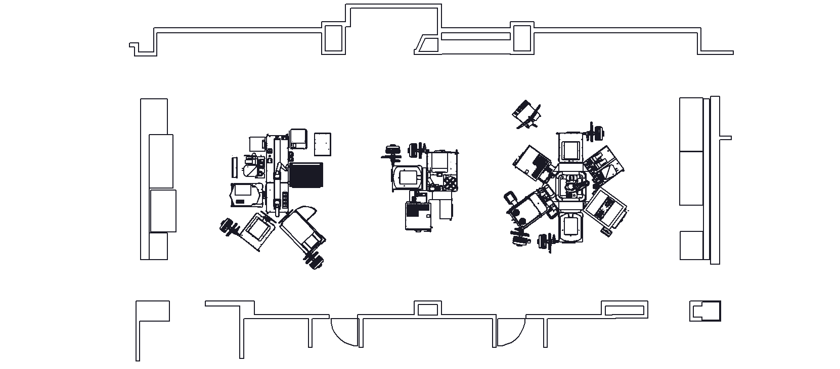
3 New Automated Systems – Lab Space
Atrium Windows
A-Cell Rail HTS System
(Imaging, Cell-based)
TRI-DOC – Flex Cart
(Plate Reformat, Biochemical)
Z-Cell HTS System
(Biochemical, Cell-Based)
Existing Automation Space
Tissue Culture
Tissue Culture
Office Suite

Slide 6
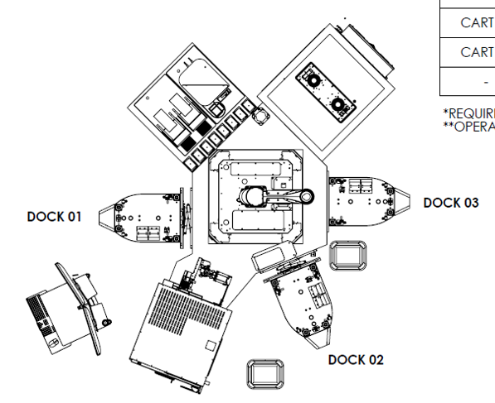
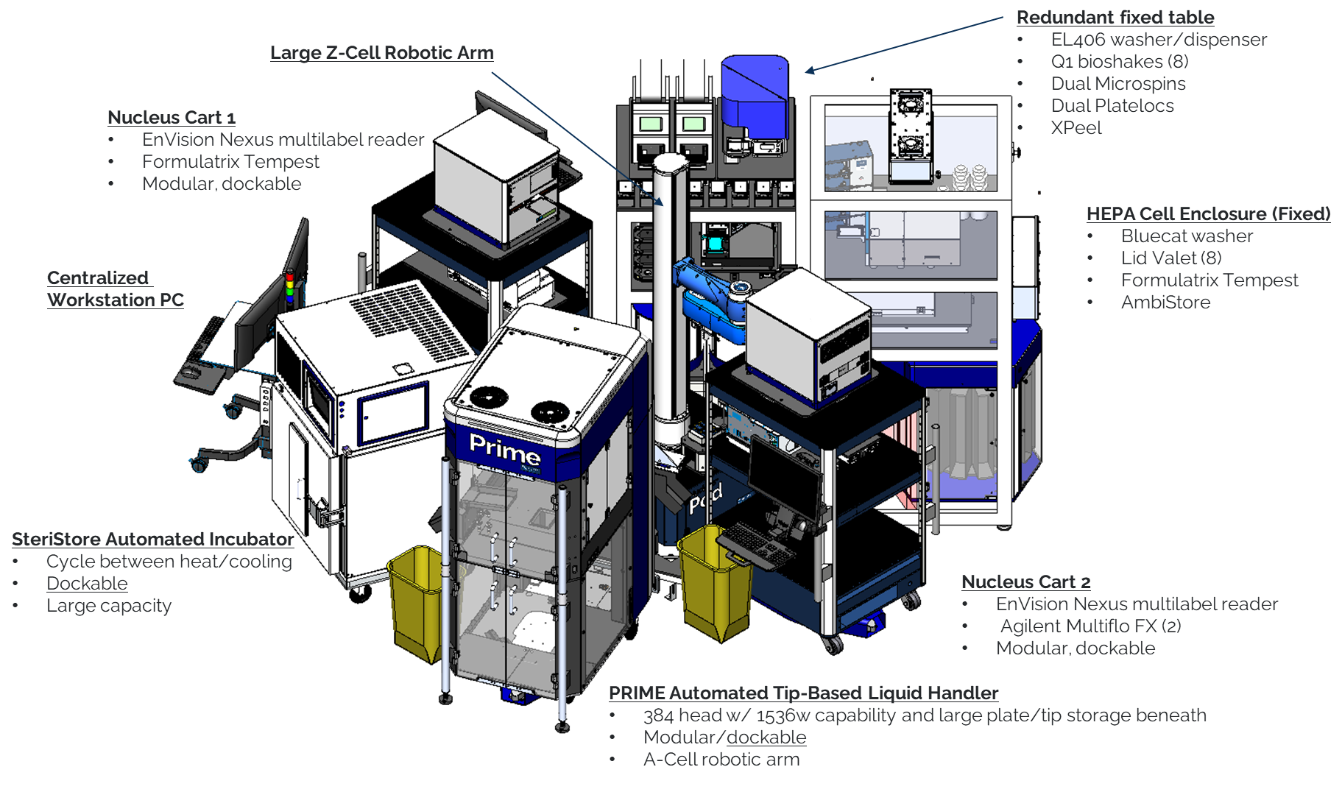
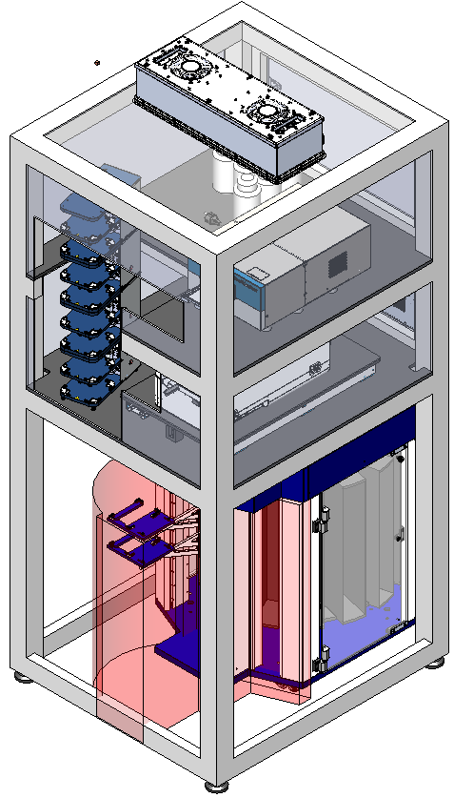
Z-Cell HTS Screening System: Flexibility
Dock Configuration
HEPA Enclosure
Cell-based work

Slide 7
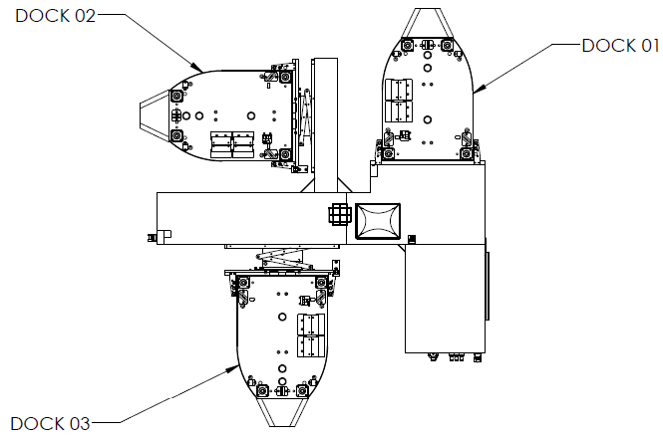
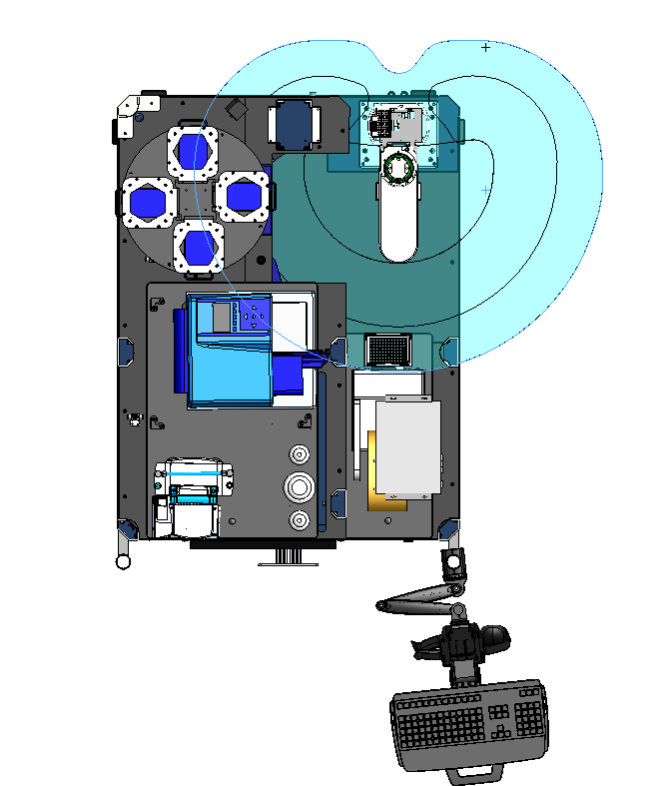
TRI-DOC – Assay Plate Reformat/Biochemical HTS​
Dock Configuration
EnVision Nexus Cart
Tempest
Echo Flex Cart
Flex Cart – Reach Envelope
CERTUS Flex
Configuration
Limits (Dock 2)
Microspin
XPeel
Plateloc (gas-purge)
HighRes Prime
Gantry (Storage)
PicoServe

Slide 8
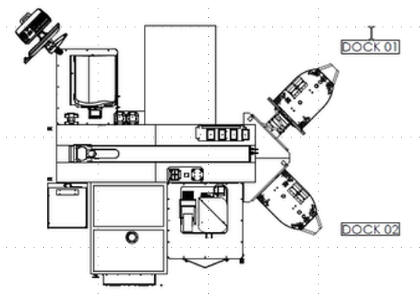
A-Cell Rail (Imaging) HTS System
Dock Configuration
Fixed Table
Echo
Mutidrop Combi (2)
A-Cell Rail (1.5M)
Chemical Exhaust (PFA) Enclosure
EL406 washer
Dockable Positions
Phenix Imagers or as appreciate
Fixed Table
AmbiStore
XPeel
Plateloc
HEPA Enclosure
Formulatrix Tempest
Liconic Automated Incubators (2)
Heating/cooling

Slide 9
3 System Build – Lessons Learned
DO NOT under-estimate the time commitment – facilities, architects, HTS vendors.
Weight, height, future expansion
Engagement with EHS early and often.
System requirements (HEPA enclosures, chemical exhaust).
Safety/Risk Assessments.
FAT/SAT protocol design – this will make or break when production starts.
Work with HighRes on protocol design, labware, etc.
Integration of older existing equipment with new systems
Camera equipment needs, remote connections (RDC, Net Support).
After hrs monitoring, error recovery.
Data/cloud integration (network and workflows).
HighRes cart – parking locations.
New workflow requirements – speak up!
PFA venting
Metal lids for cell-based work.
PEOPLE! It takes a village – vendors, architects, building managers, movers, floor scanners, electricians, contractors, IT/digital, EHS, the list goes on-and-on!

Slide 10
The Team / Acknowledgements
ATCM Liquid Store
Discovery Biology & Pharmacology
Facilities & Team
Travis Mathewson
Ryan Arnold
Francisco Roman
Benjamin Rumrill
Janice Palmer
Eric Johnson
Rich Frisbie
Tony Chow
Lucy Rogers
Jacob Bunch
Sara Hyde
Jeremy Schreiner
Joanne Bautista
Michael Whittaker
Blake Schembri
Bobbi Barber
Kenneth Nicholson
Sam Collazo
Grodsky – Louis Malerba & Team
Dinto Electrical – Jim Clabby, Jeff Fortier & Team
Carlin Construction – Bill Donovan, James Carlin
TLBA – Chris Strange
Regis Doyonnas
Paula Loria
Tim Foley
Zane Wenzel
Stephen Noell
Fabien Vincent
Josh Hamm
Brian Munton
Zack Gural
Joe Blethen
Business Engagement
Joe Mongillo
George Hajj
HTS Expansion Team
Andrea Weston
Markus Boehm
Shree Khunte
Matt Troutman
Digital
Claire Steppan
Sylvie Sakata
Matt Sammons
Greg Owens
Christine Guiliano
James Villano
Equipment / HTS Vendors
HighRes
Formulatrix – Cem Sonmez
Revvity – Jordan Attwood, Hafeez Khan
Lab Machines – Brandan Barry
Agilent – Tom Nicholson
BlueCat
Azenta
QInstruments
Thermo Fisher Scientific
Genedata
Environmental Health & Safety
Drew Glatczak
Michael Smith
Nicholas Holan
Gary Perez
Kevin Moccia
Dachao Kuang
Tony Tesoriero
Nat Fullam
Josh Powers
Chris Erikson
Phil Soucy
Tommy Chhim
John Rodrigues
Dally To
Eric Watters
Jean Ferris
Timothy Green
ERS
Michelle Salafia

