Slide 1
Streamlining Discovery Sample Management with HighRes Bio Automation
Merck Rahway <> HighRes SLAS2026 Exhibitor Tutorial: Application Focused Lab Automation
February 10, 2026
Joe Cowan & Sevan Ibabekci
Merck & Co., Inc., Rahway, NJ, USA

Slide 2
Request Fulfillment & Data Integration

Slide 3


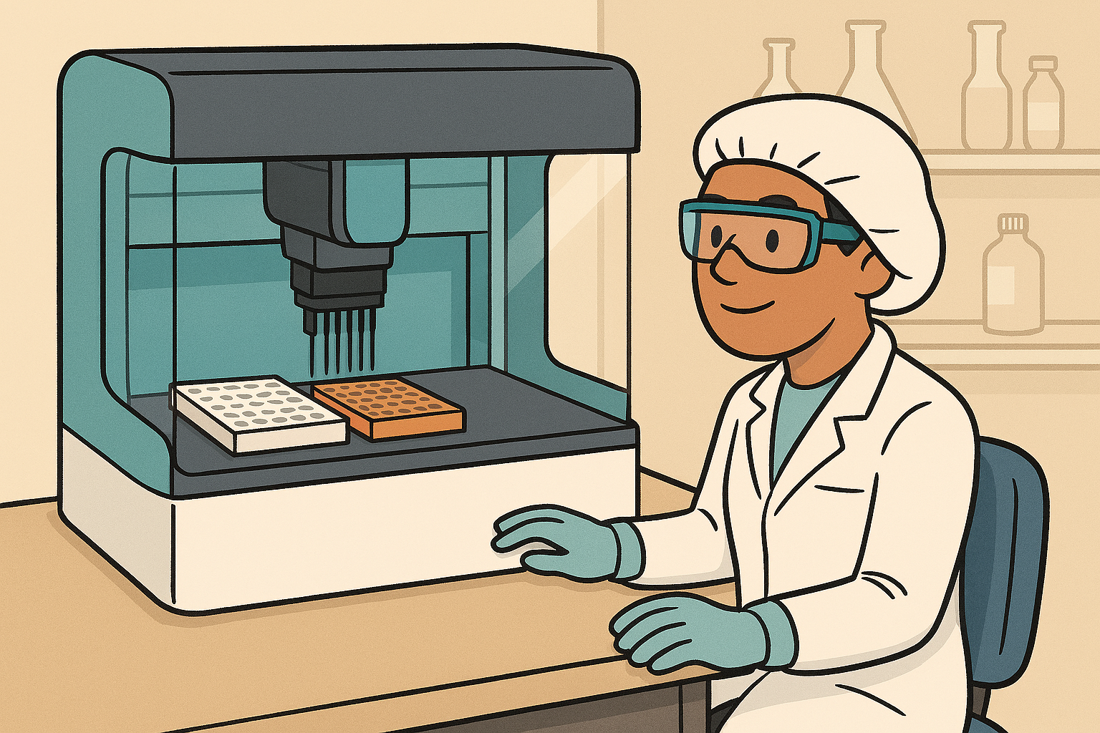
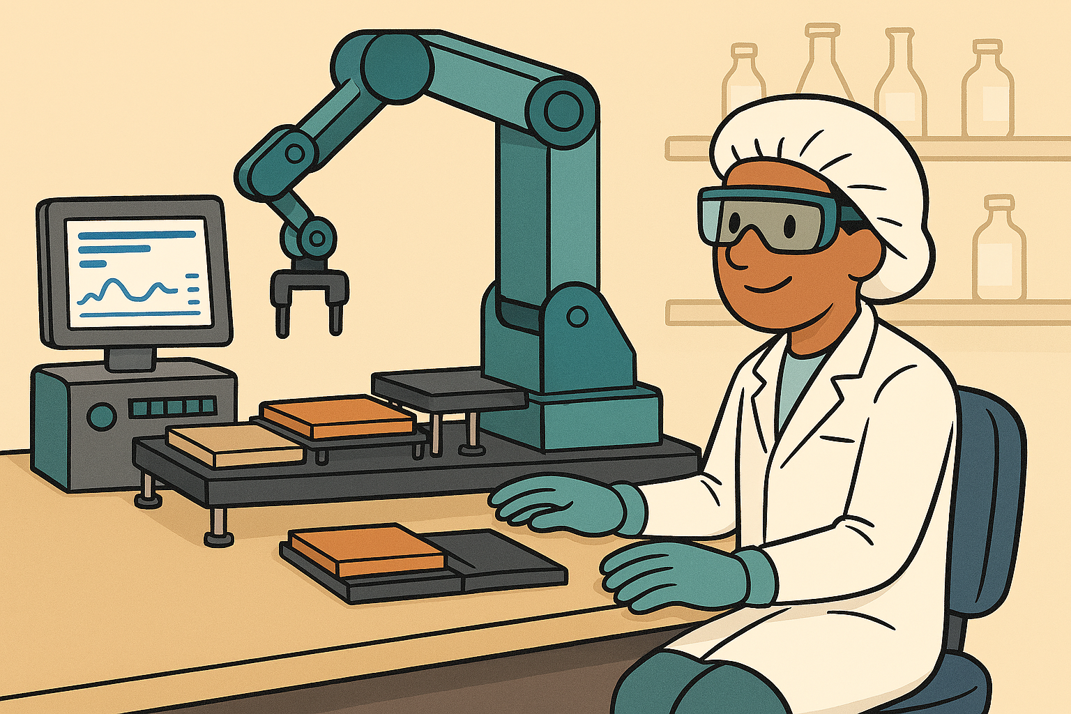
Gather Assay Requirements: Meet with scientists on assay details and next steps. In-house dashboard created to capture and track new assay requirements .
Scigilian or Mosaic Request:
-Adhoc Single Point Requests
-Assay Specific Serial Dilution
-Assay Specific nL acoustic dispensing
- Large Compound Library (uL)
Mosaic Order Fulfillment:
Discovery Sample Management (DSM) team reviews & fulfills orders

Slide 4
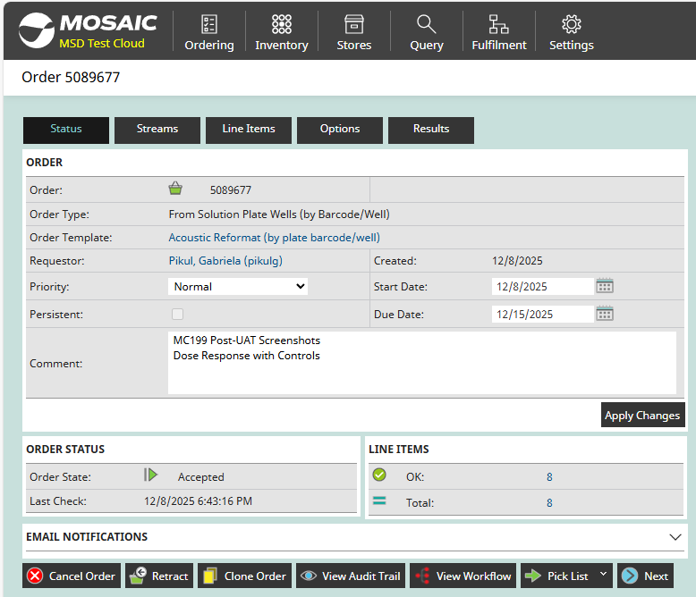
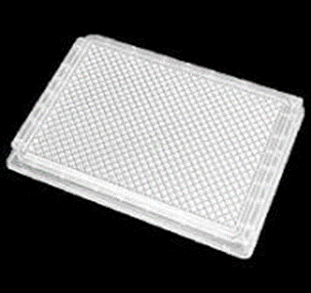
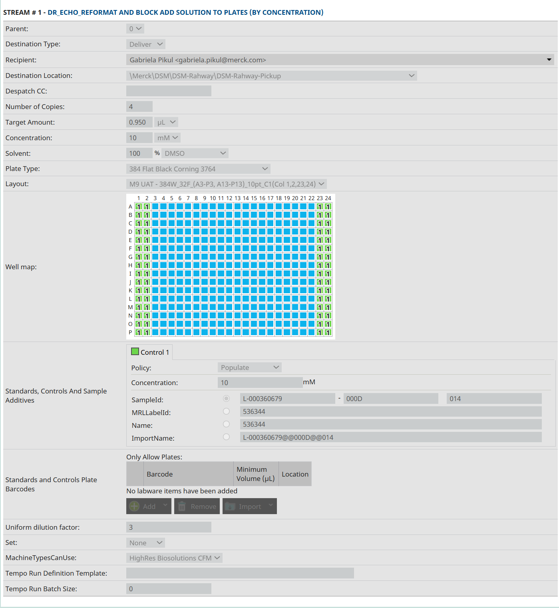
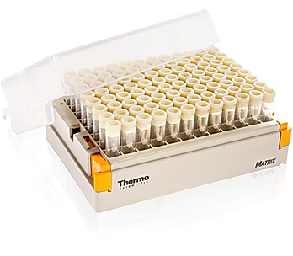
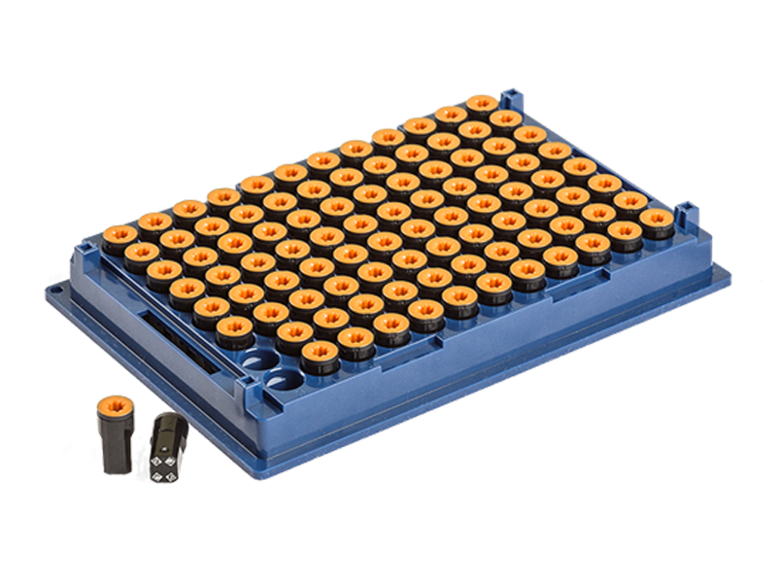
Mosaic Order
v
v

Slide 5
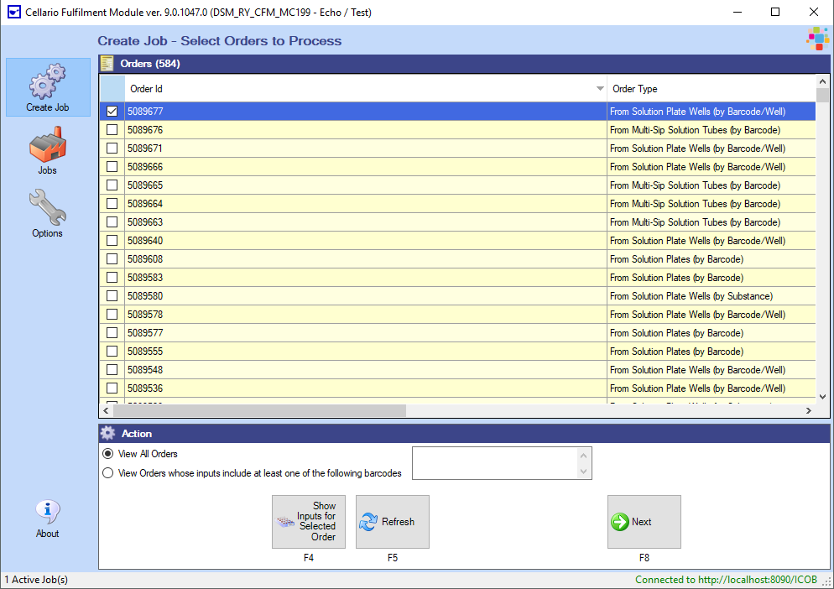
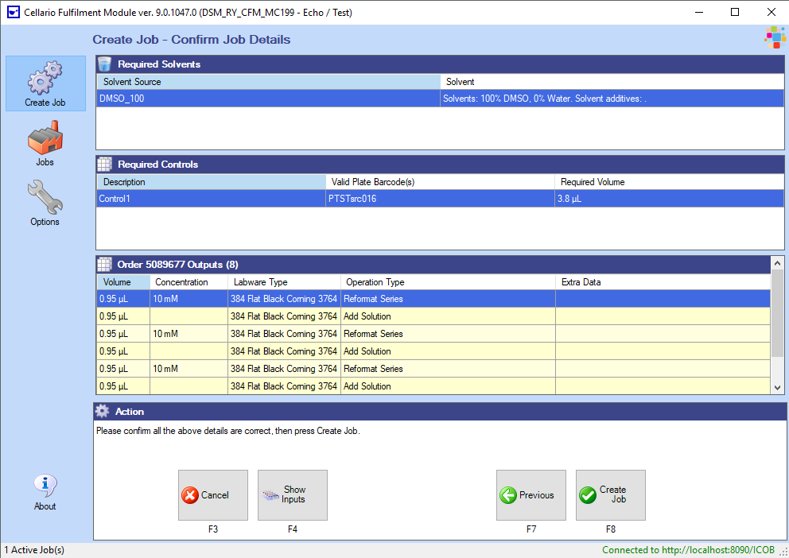
Cellario Fulfillment Module

Slide 6
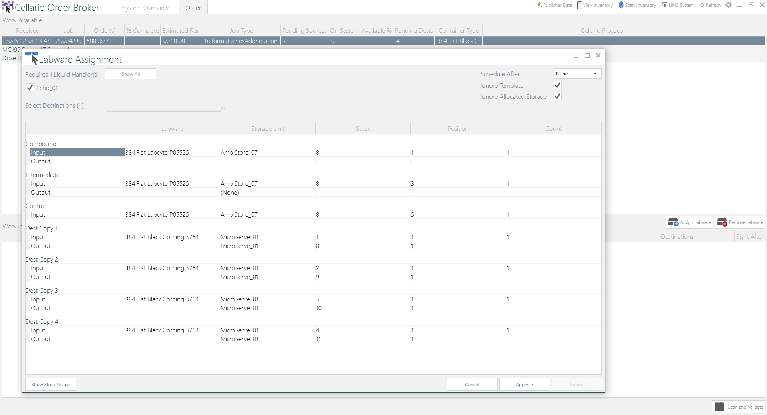
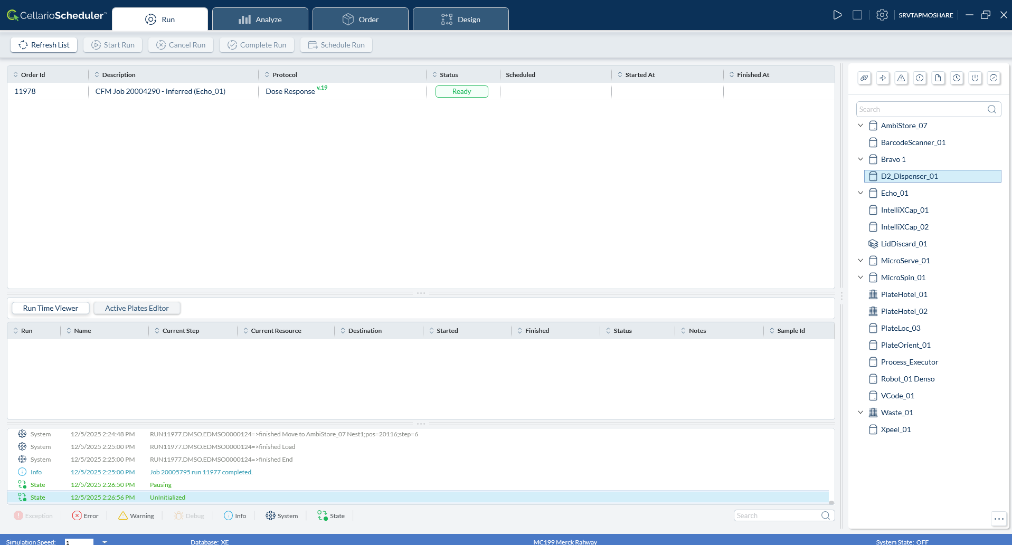
Cellario Order Broker
Cellario 4.2

Slide 7
MC660 & MC789
February 10, 2026
Joe Cowan & Sevan Ibabekci

Slide 8
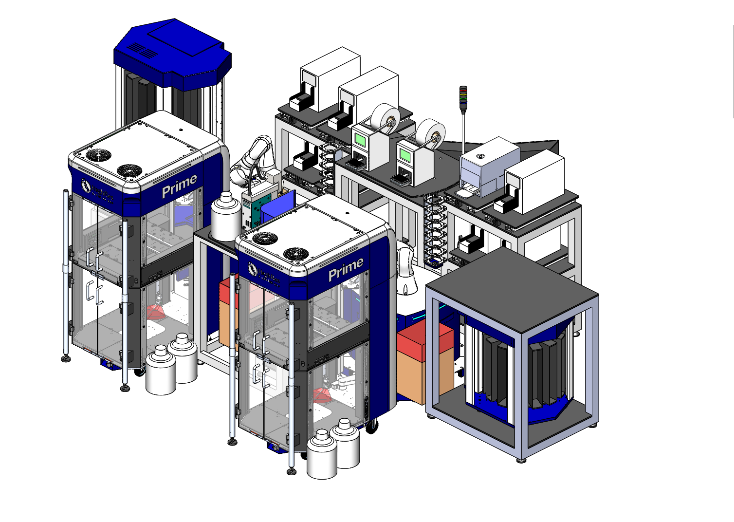
MC660 & MC789

Slide 9
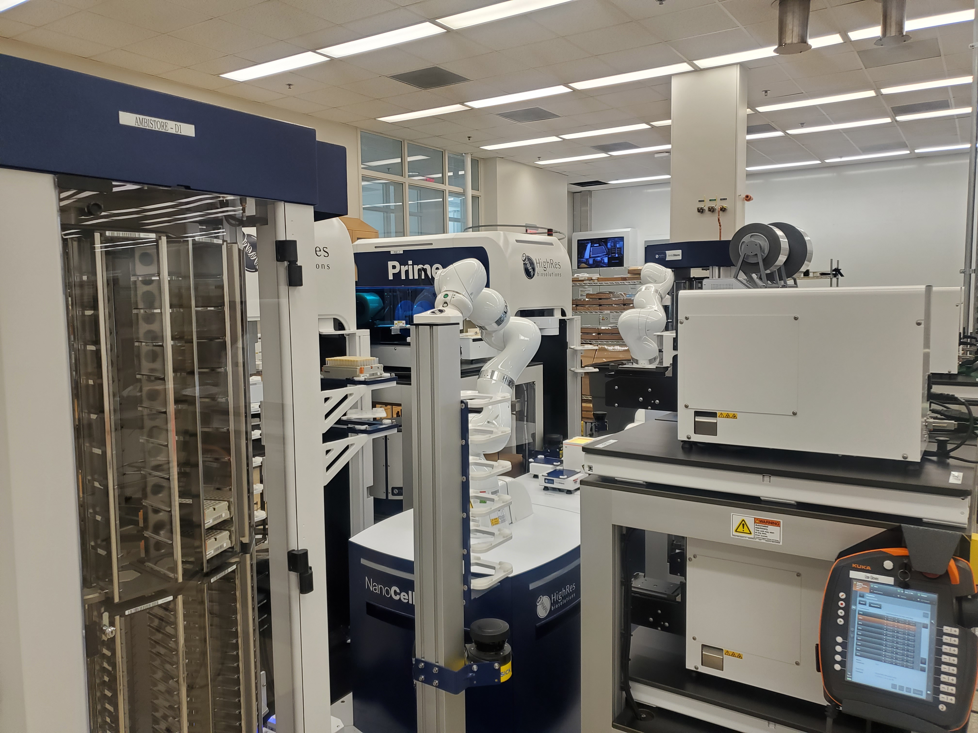
Kuka Arms (2018)

Slide 10
Kuka Arms (2018)

Slide 11
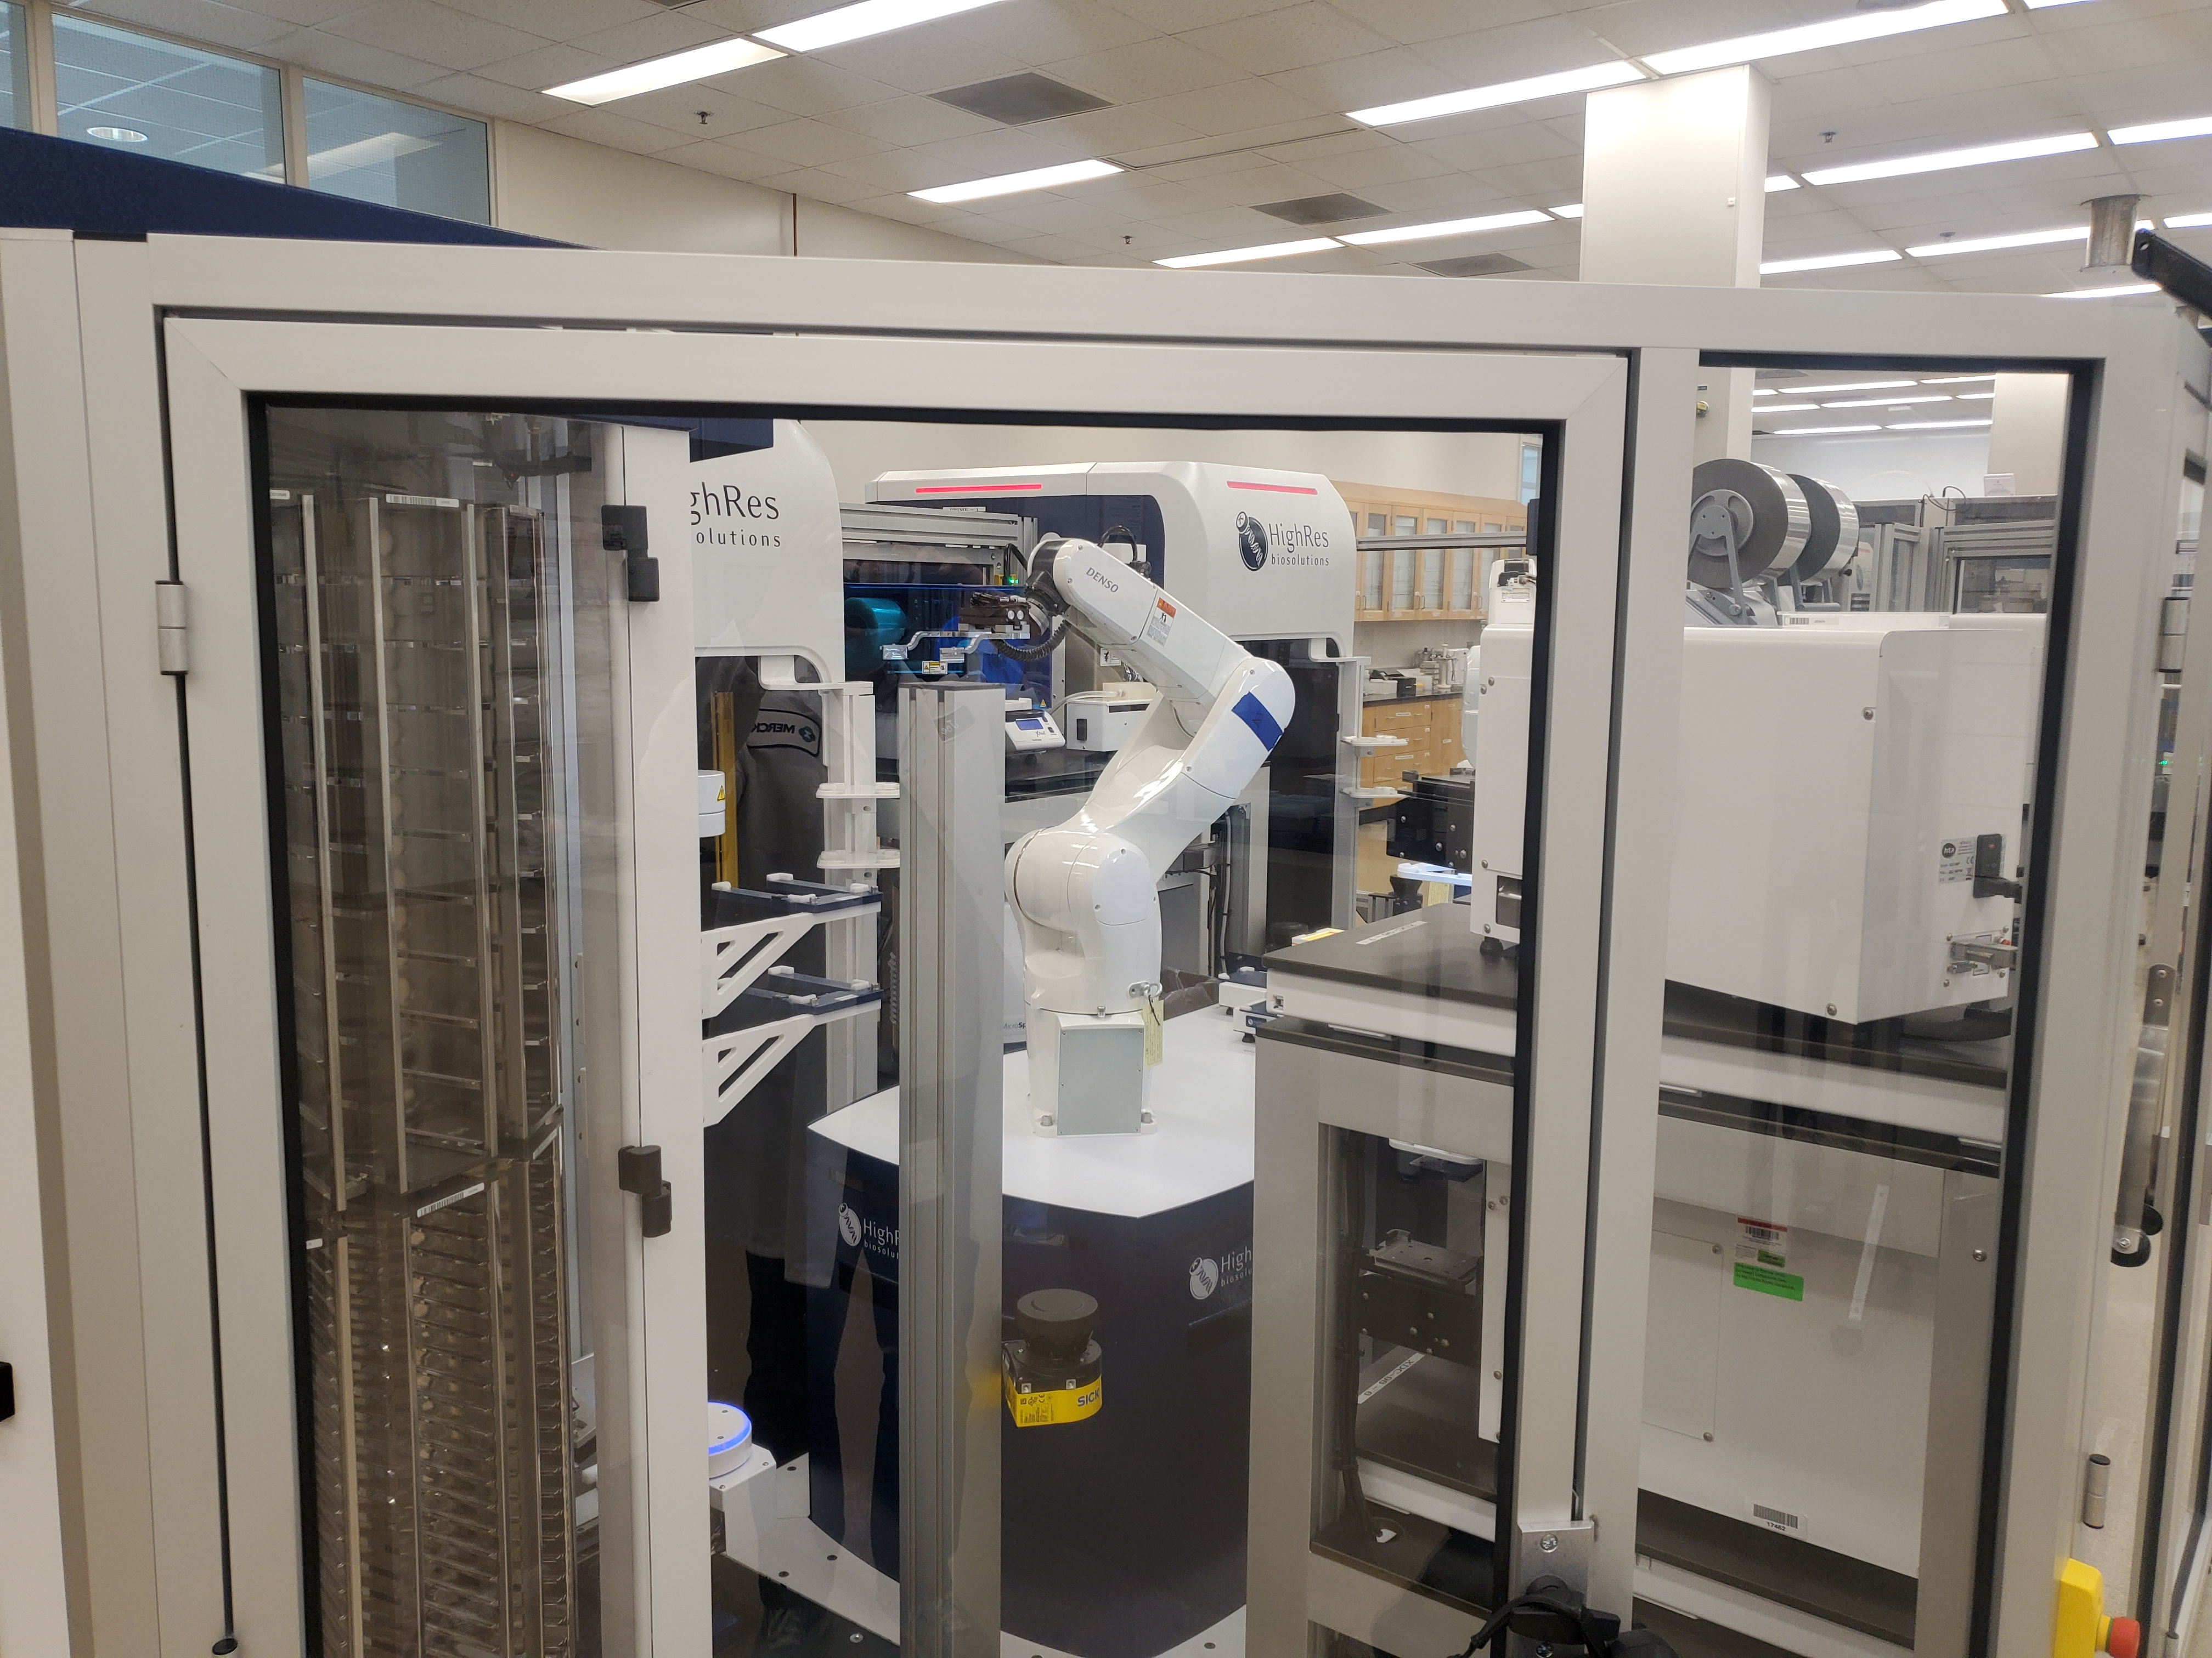
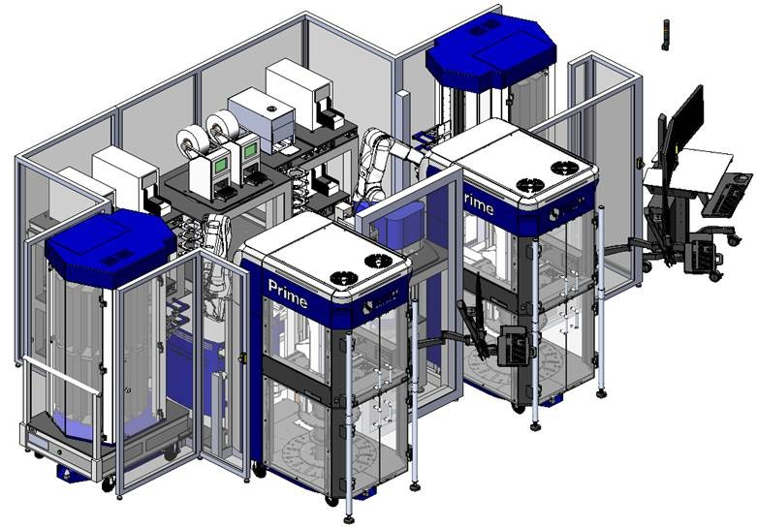
Kuka to Denso Arms (2022)

Slide 12
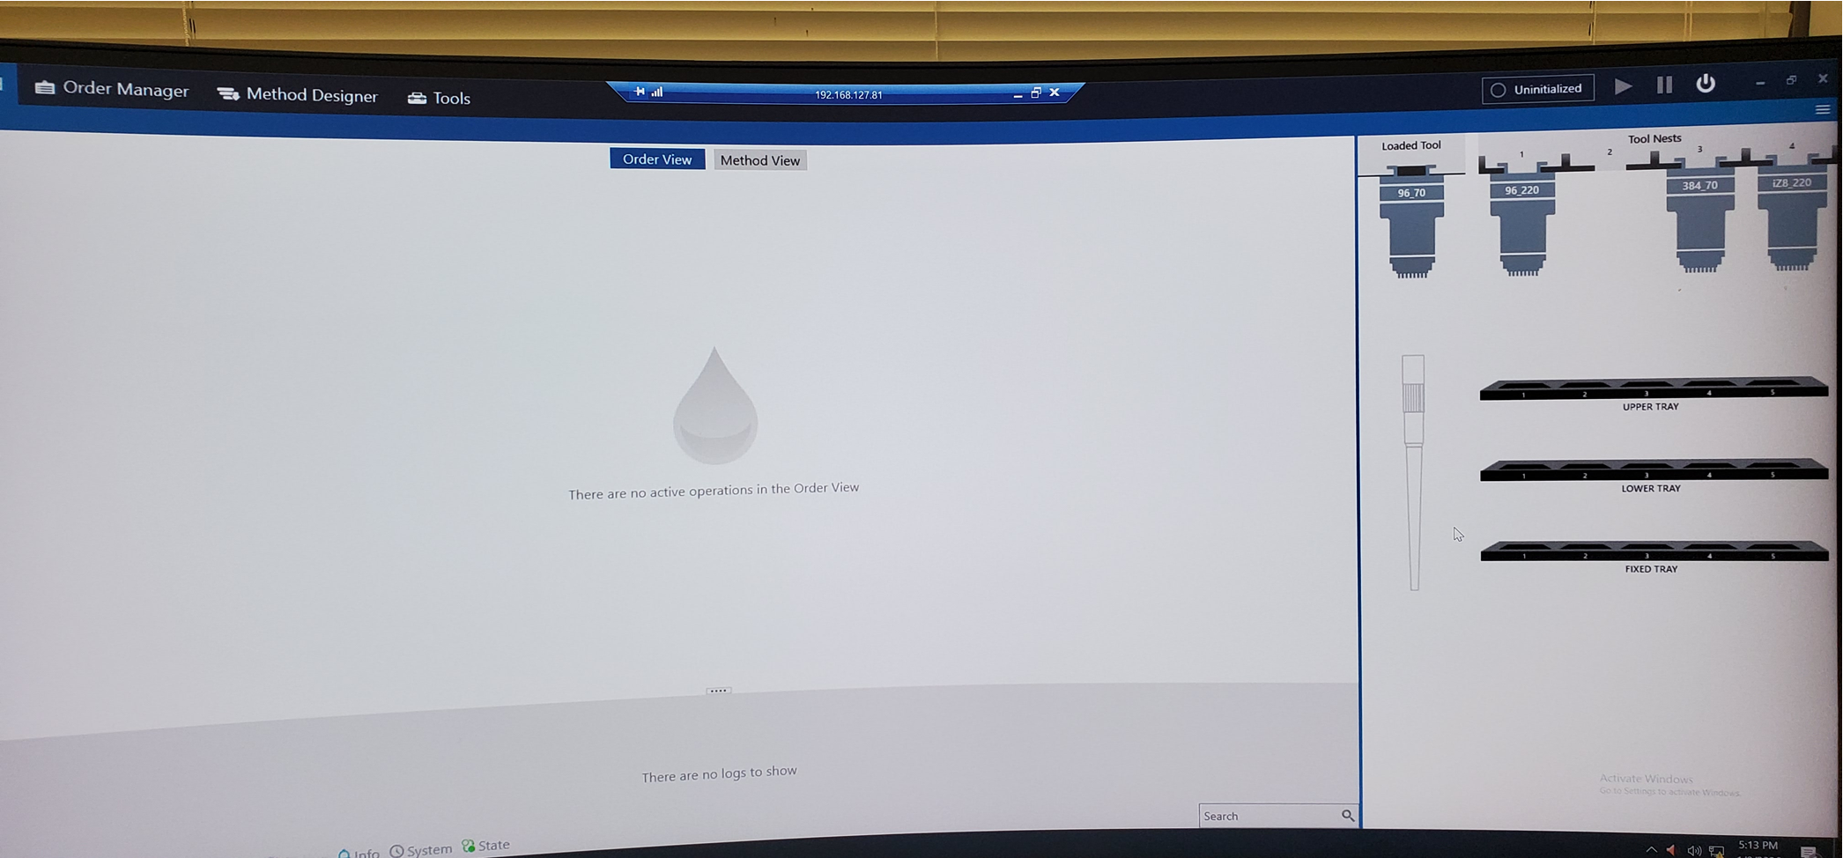
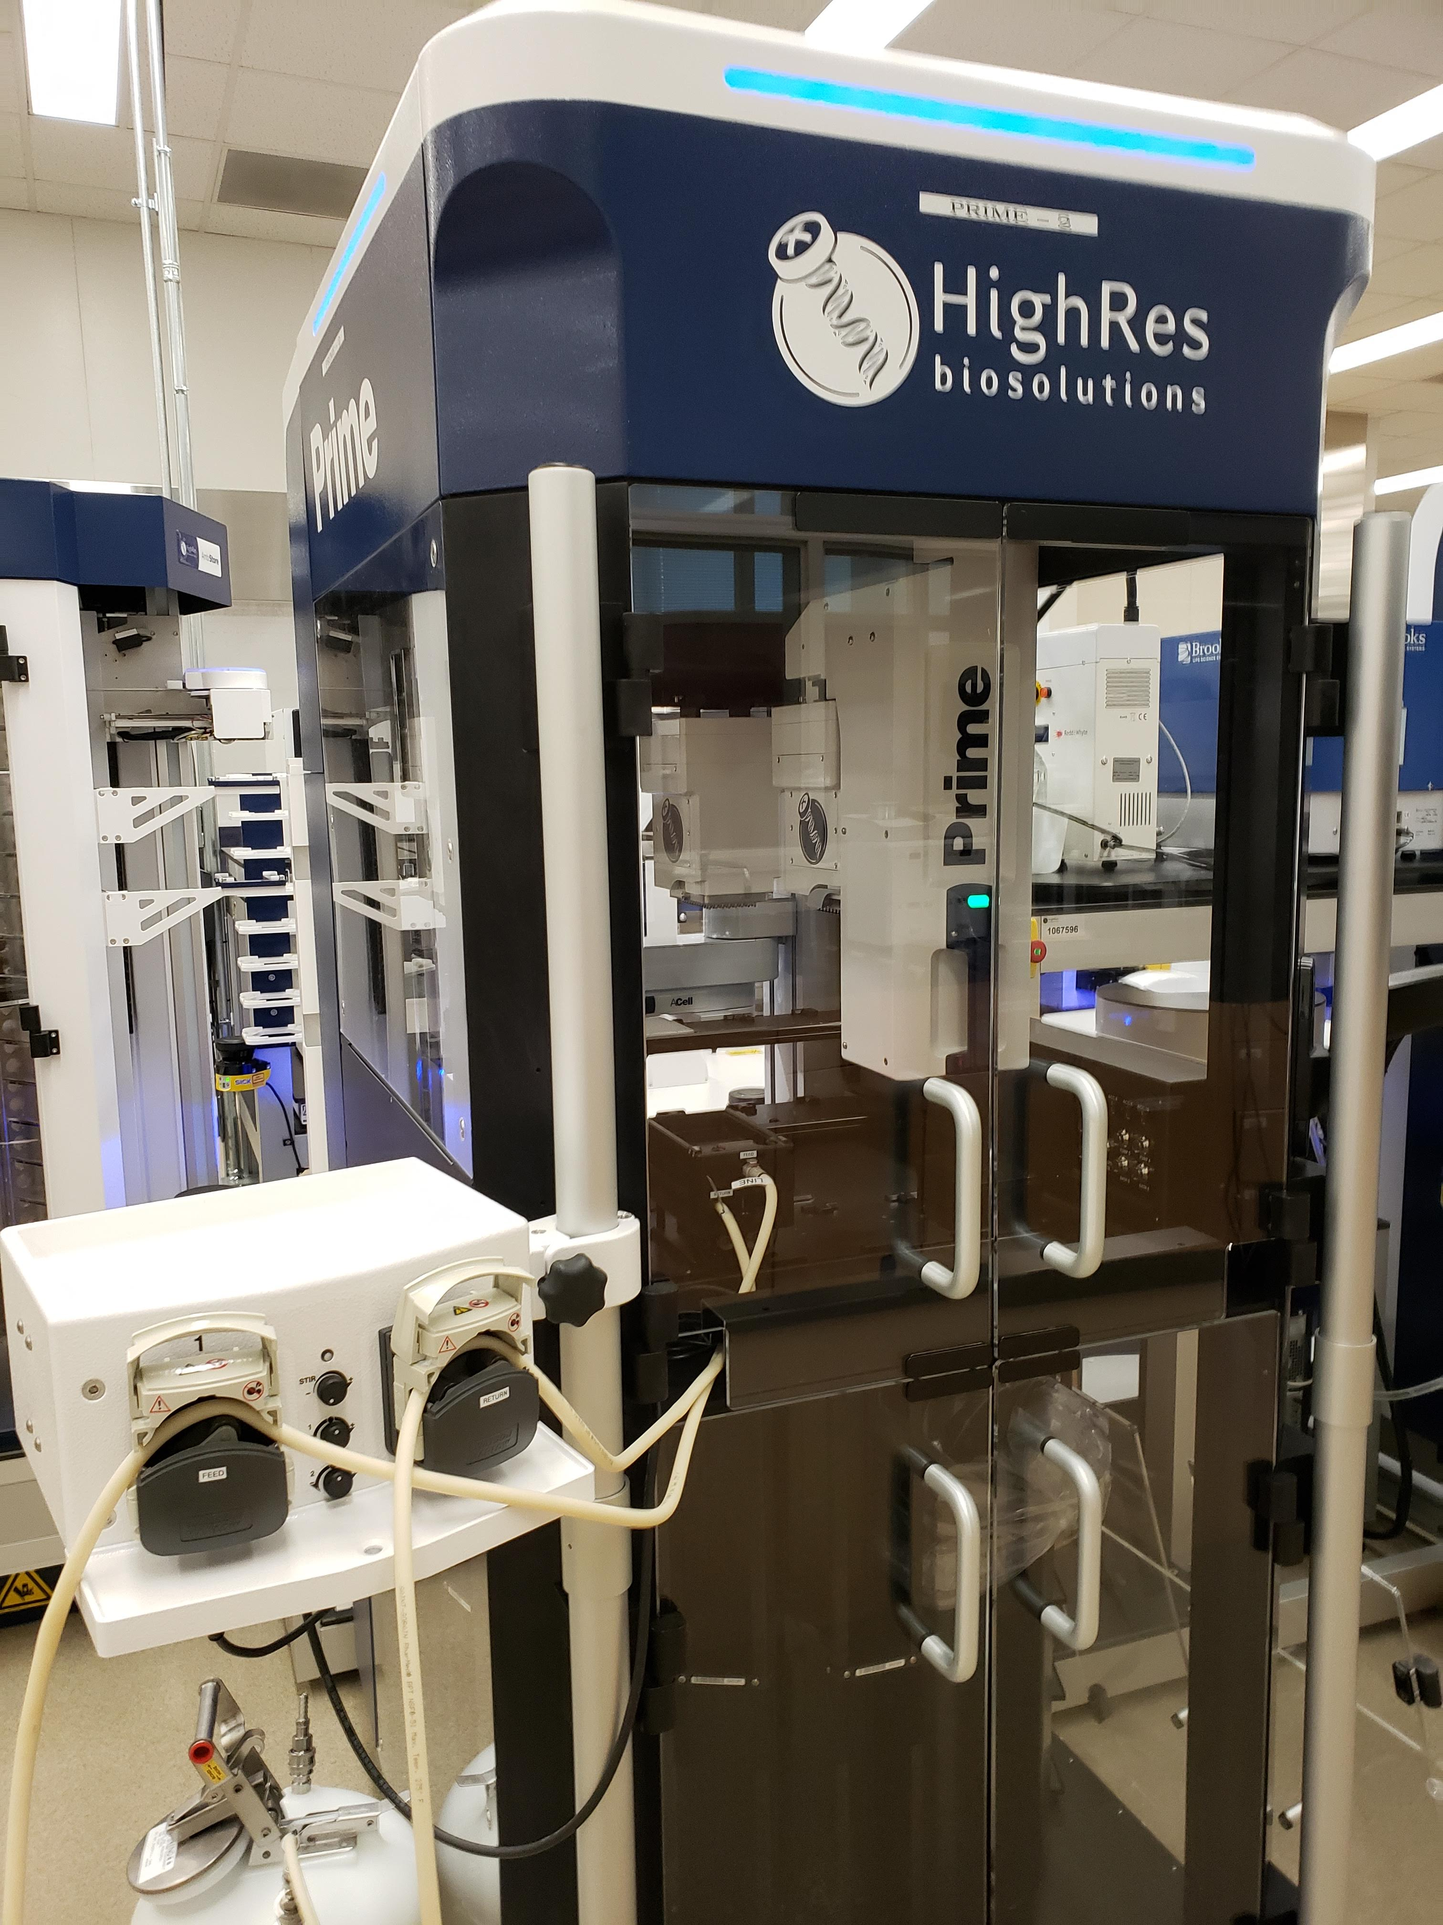
Primes & Solution

Slide 13
MC199
February 10, 2026
Joe Cowan & Sevan Ibabekci

Slide 14
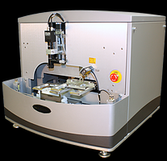
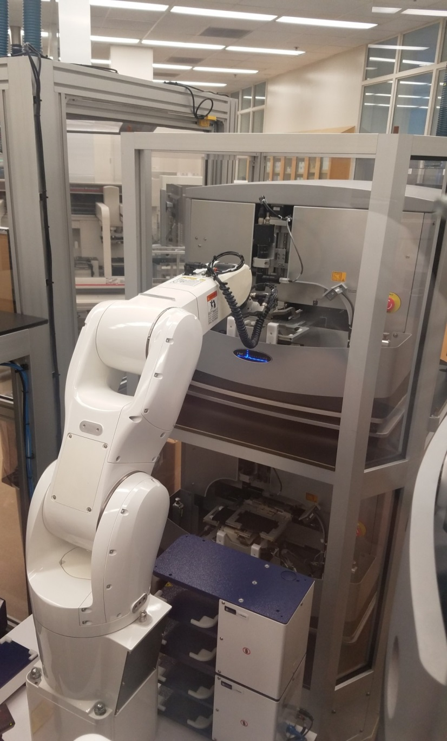
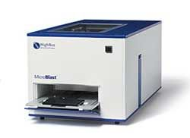
ATS Acoustic Dispenser
How It Started (2017)
How It Started (2017)
Microblast Air Knife

Slide 15
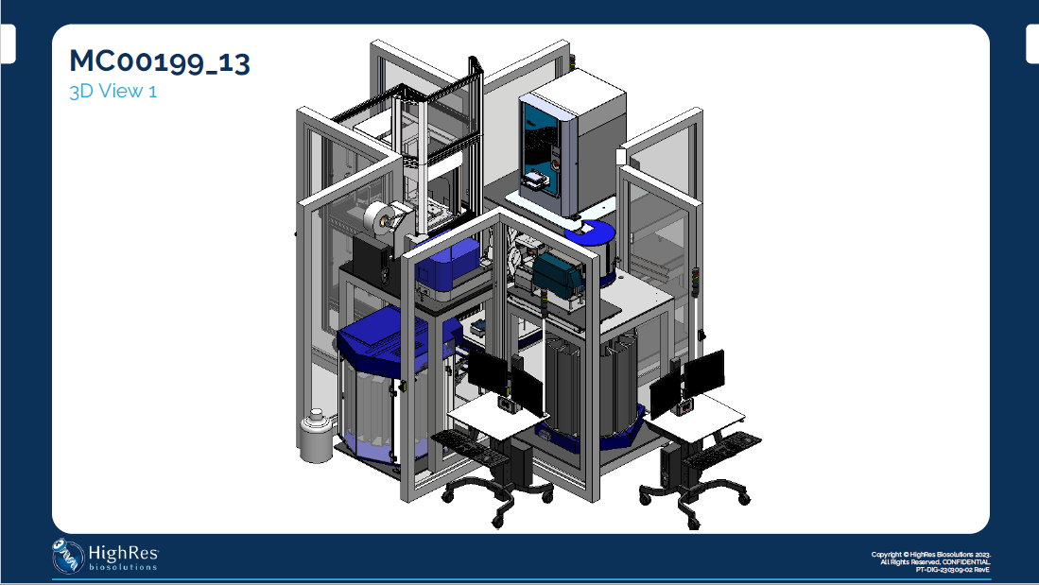
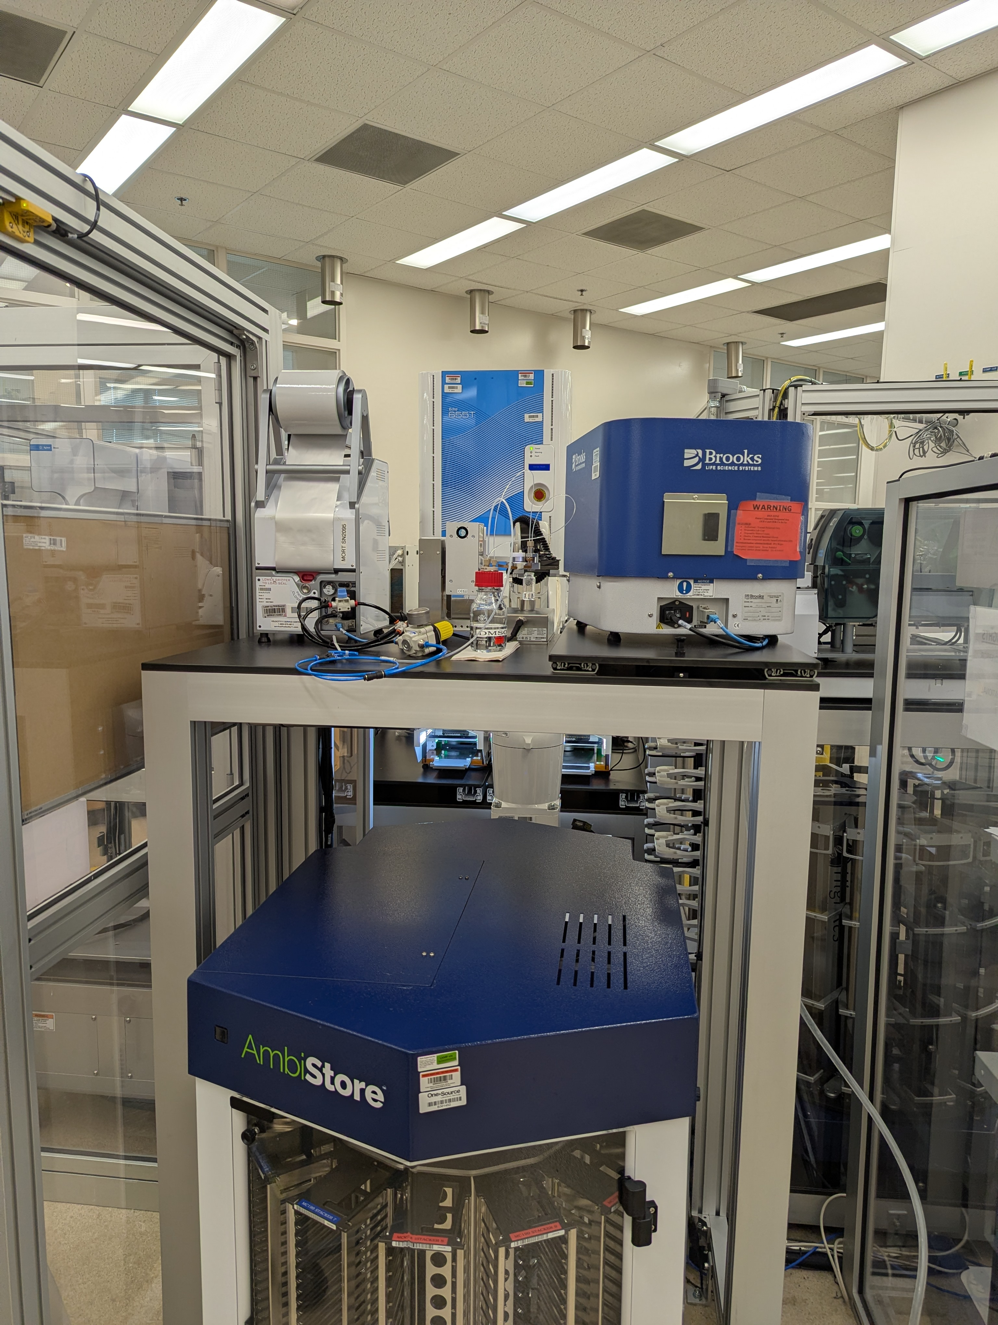
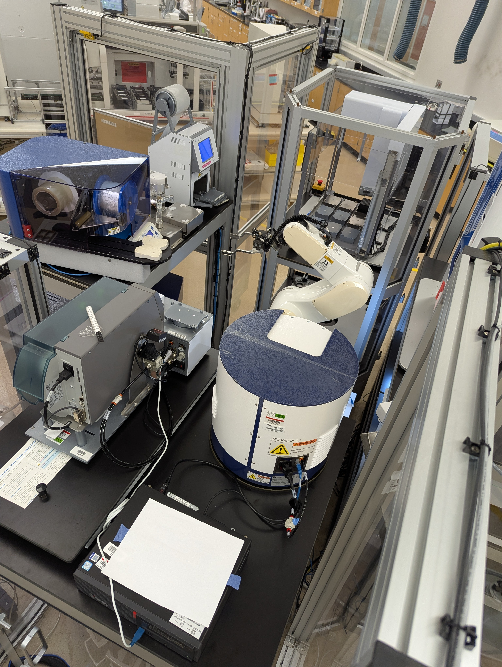
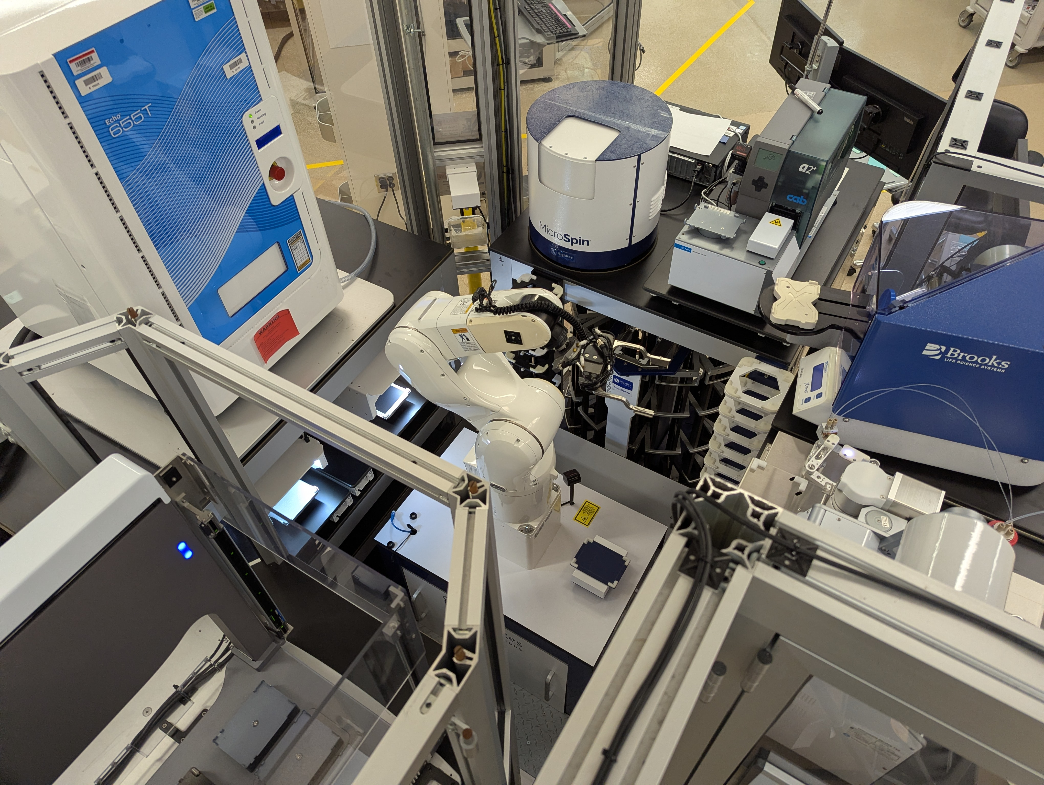
How It’s Going (2025)

Slide 16
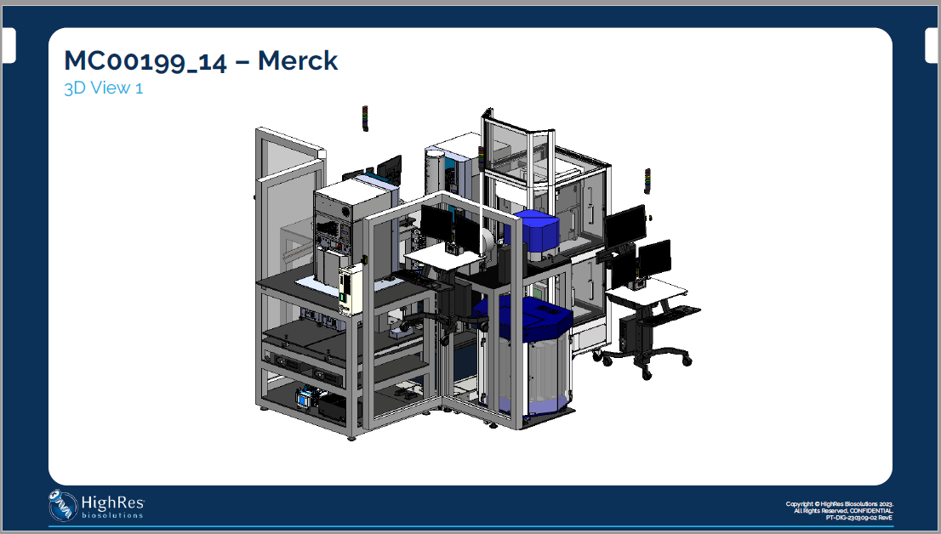
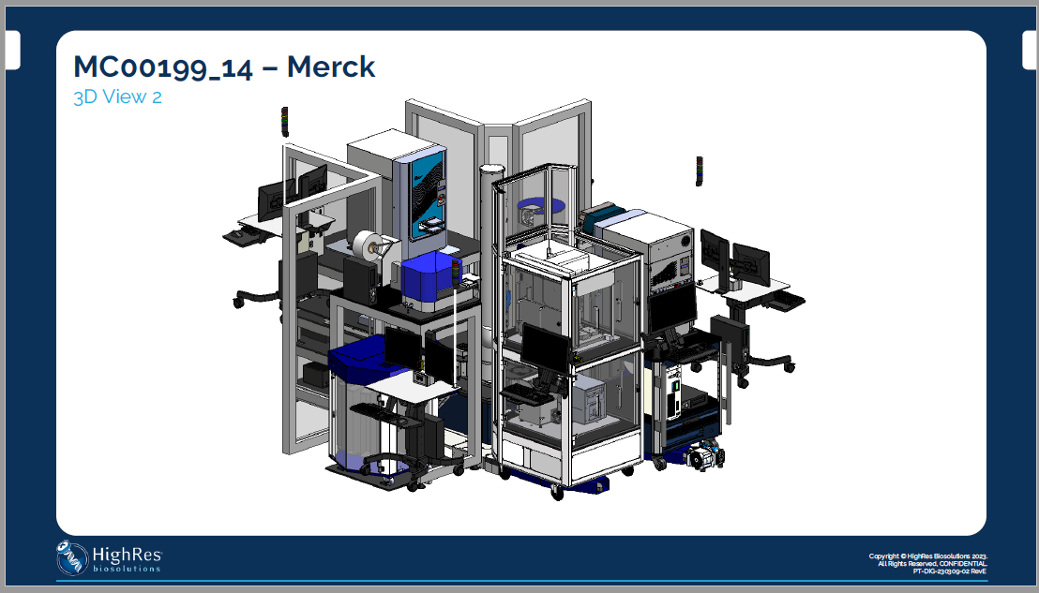
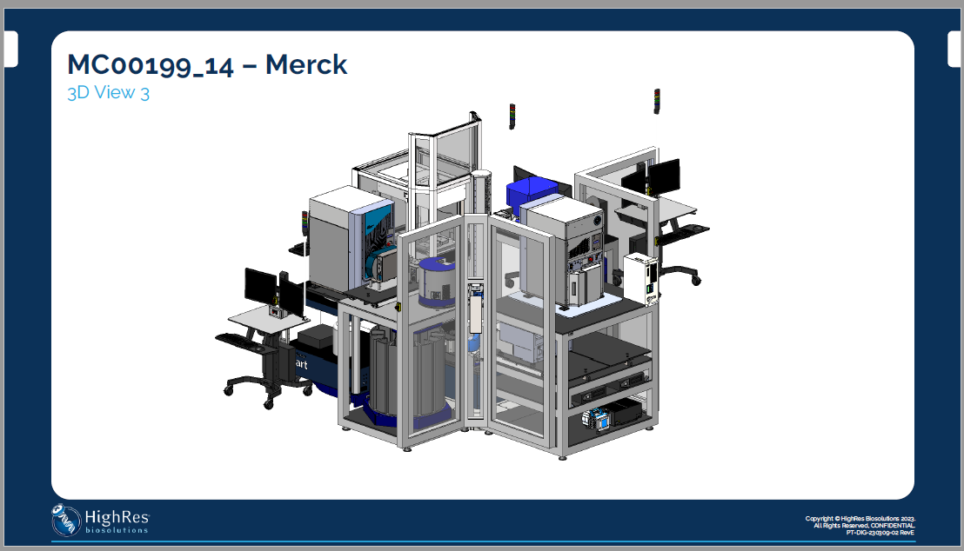
Where It’s Going (2026)

Slide 17
Key Considerations & Challenges
Engage with stakeholders for short-term and long-term planning
Flexible systems
Engage with IT & Safety
Do your research and get customer feedback
Service contract from vendors
Missed requirements
Staff skill sets
Management of changes
Intermittent crashes
Offline tools & workflows to fill in integration gaps
Optimizing Cellario scripts
Tip manufacturing issues

Slide 18
Acknowledgements
Monica Betancur
Marybeth Burton
Joseph Cowan
Janet Diratsouian
Rachel Feller
Sevan Ibabekci
Vijay Kanthan
Gabriela Lurski
Duncan McNicol
Susana Morais
HRB Support Team
Cenevo Support Team

Slide 19
Thank you

