Slide 1
HighRes Automation at Enveda
Transforming Small Molecule Drug Discovery with Machine Learning & Metabolomics
Katie Heiser, Director of Platform Biology
SLAS 2026

Slide 2
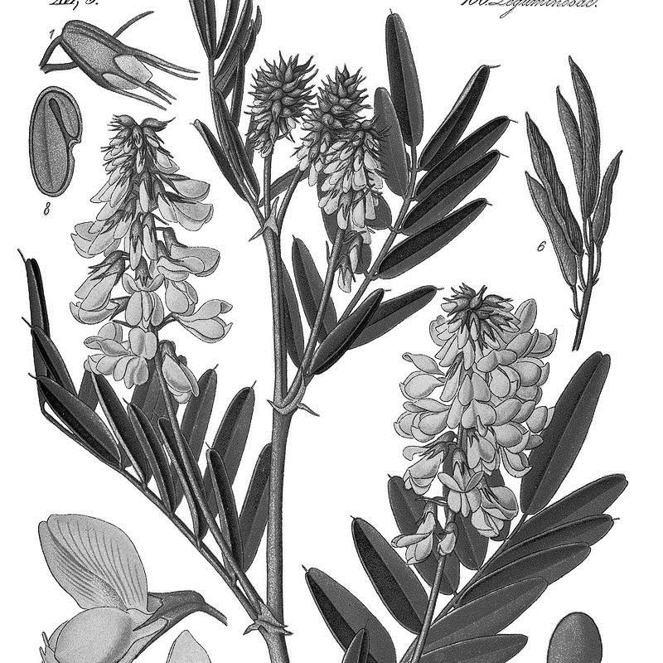
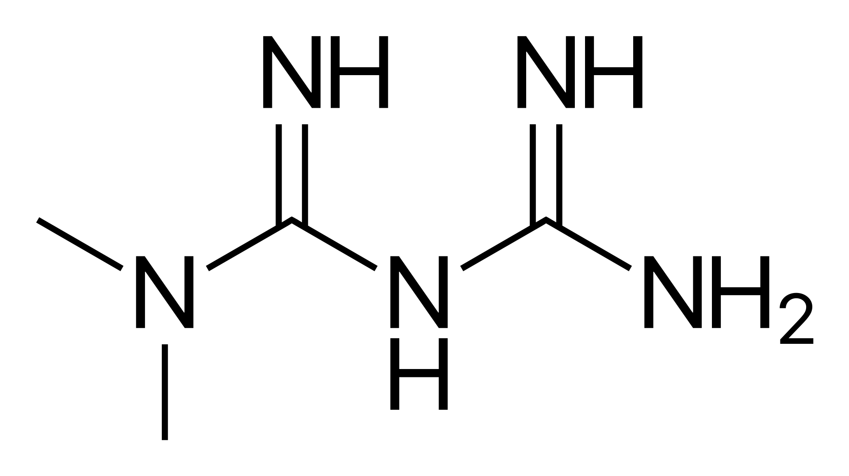
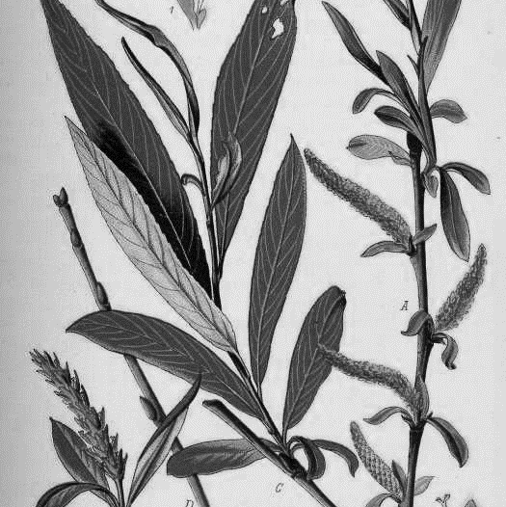
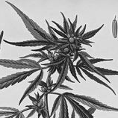
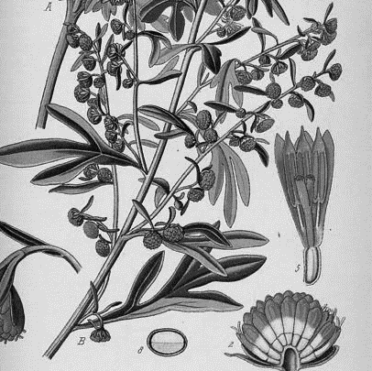
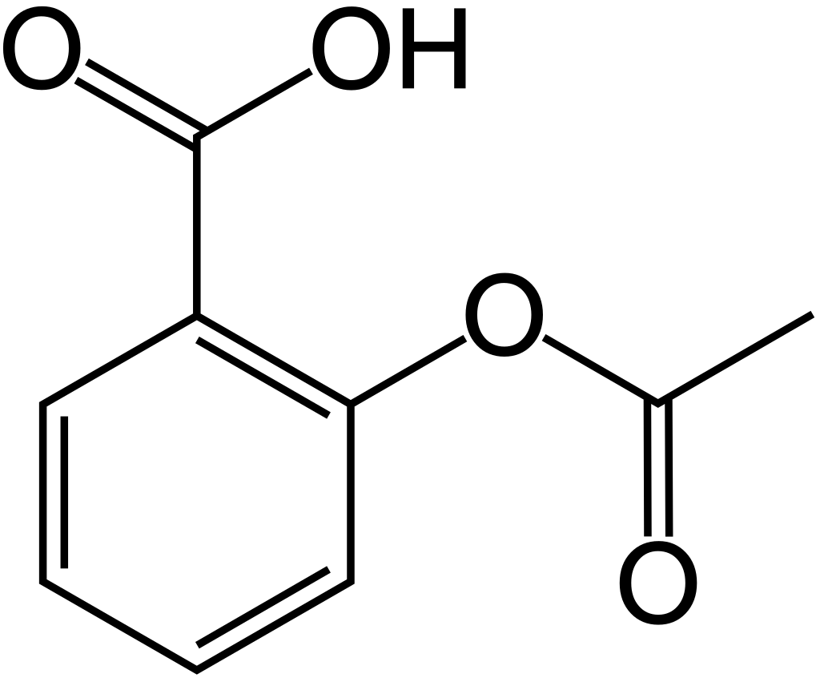
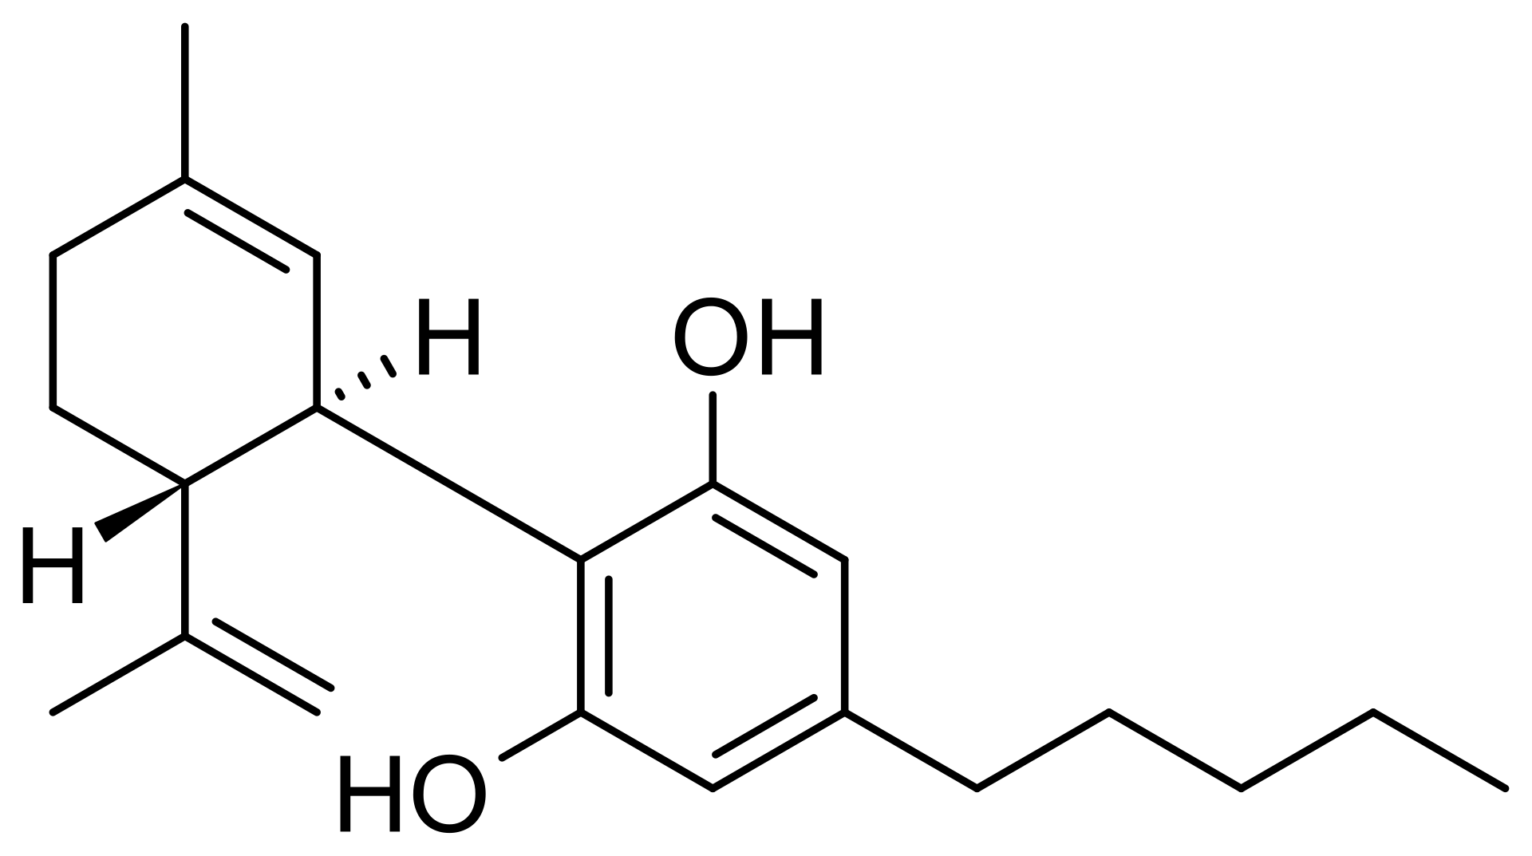
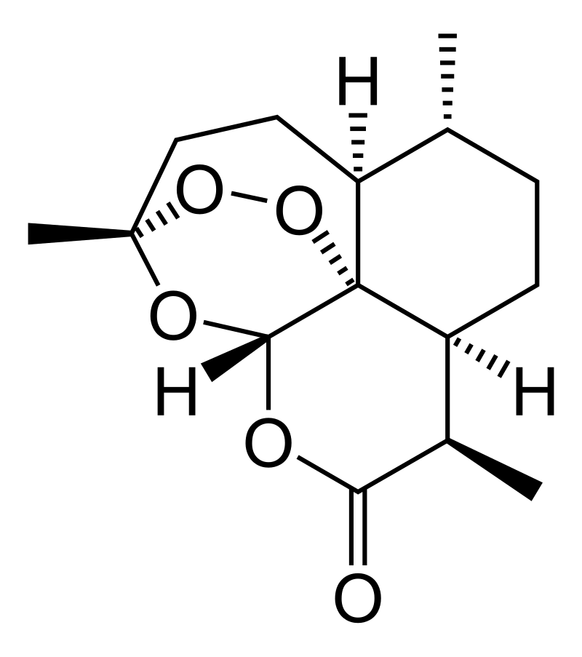
Nature has been an incredible sources of medicines
METFORMIN
Galega officinalis
Salix alba
Cannabis sativa
ASPIRIN
Artemisia annua
CANNABIDIOL
ARTEMISININ

Slide 3

All rights reserved, 2023.
Nature’s chemistry represents the most validated yet untapped idea in drug discovery
PROVEN SUCCESS
UNTAPPED POTENTIAL
NP-like have a greater chance of clinical success: +48% relative odds of reaching Phase 3¹
2
<1%
of Nature’s chemistry is known
<1%
of Natural Products are known to science
NP - LIKE
+48%
1
RELATIVE SUCCESS RATE
SYNTHETIC
0
Phase 1
Phase 2
Phase 3
¹ Domingo-Fernandez, et al. Natural Products Have Increased Rates of Clinical Trial Success throughout the Drug Development Process. Journal of Natural Products. 87, 7, 1844-1851 (2024). DOI.

Slide 4




Unlocking Nature’s Chemistry at Enveda
Nature’s Chemistry
Samples from plants, microbes, fungi, etc. with 1000’s of molecules in each
The Platform
Enveda is building a chemical sequencer for life. We annotate the strucutre and function of natural compounds
The Compound
Enveda’s Pipeline team uses SAR to turn an active compound into a medicine

Slide 5


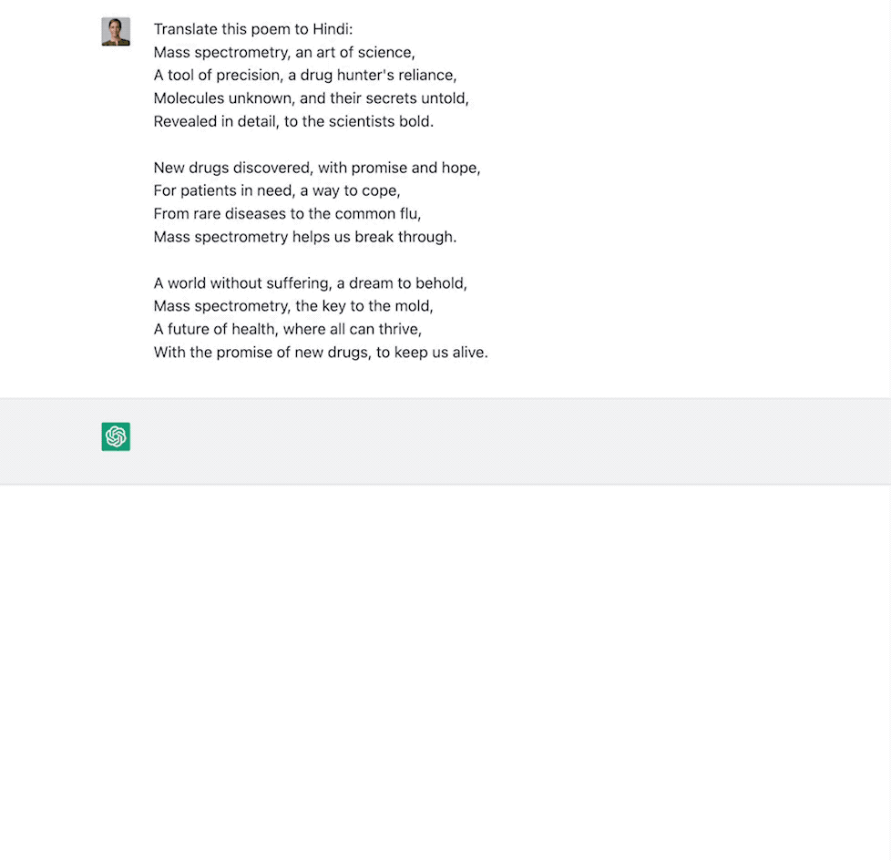


Translating nature’s dark chemistry into medicines at unprecedented speed, scale, and accuracy
ChatGPT
ML + Metabolomics: What are the molecules?
What is the function of the molecules?

Slide 6
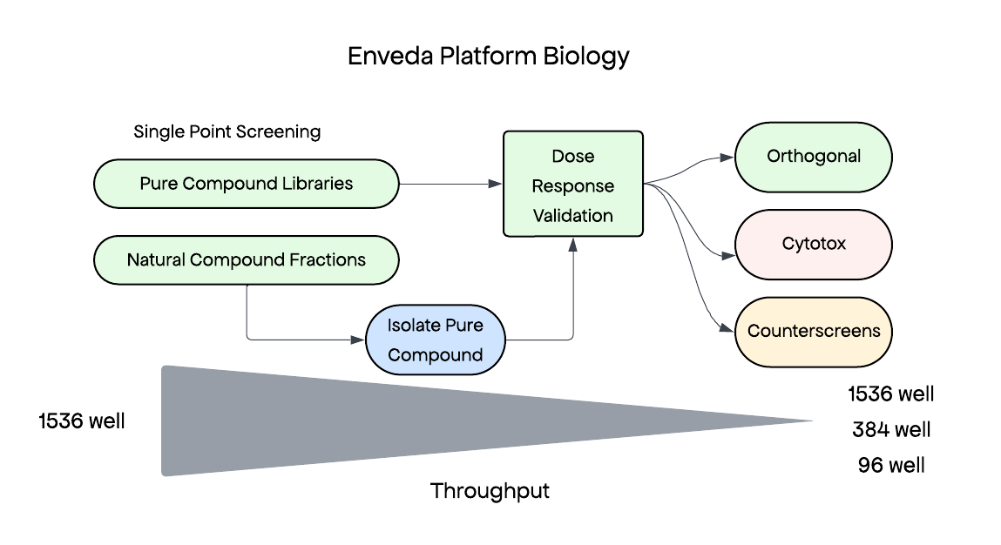








Annotating the Function of Nature’s Chemistry
Platform Biology

Slide 7
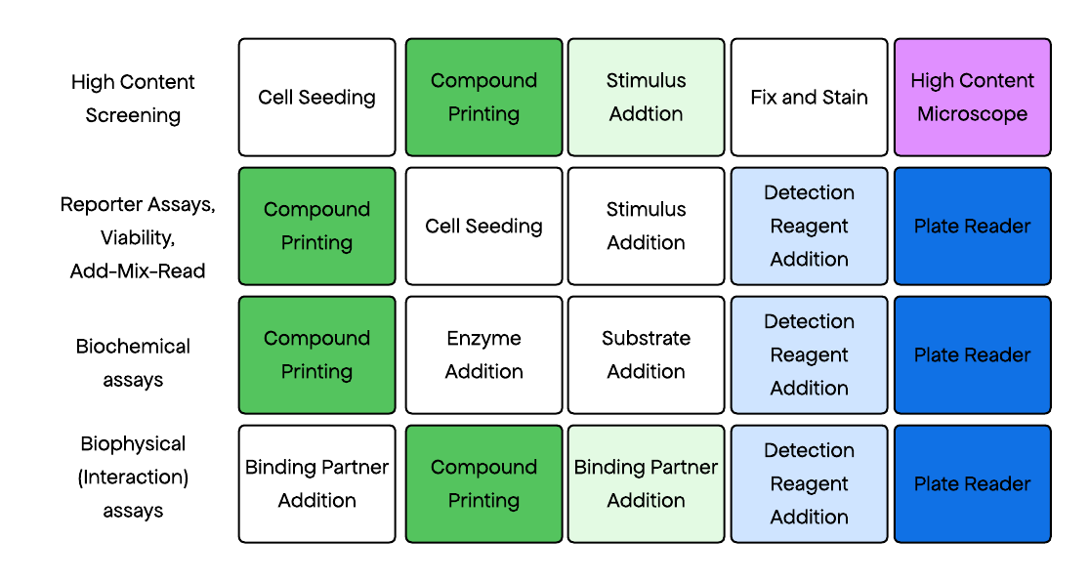
Automating Assay Workflows
Fully Automated Work Cells
Compound Printing
High Content Imaging
Add-Mix-Read

Slide 8
HighRes Automation in Platform Biology
Strategy
  Automate low-complexity, time-intensive tasks
    Compound Printing
    High Content Imaging
    Add-Mix-Read
  High capacity, fit for purpose
    Three systems with broad applicability
    High robustness
    Low scheduling complexity

Slide 9
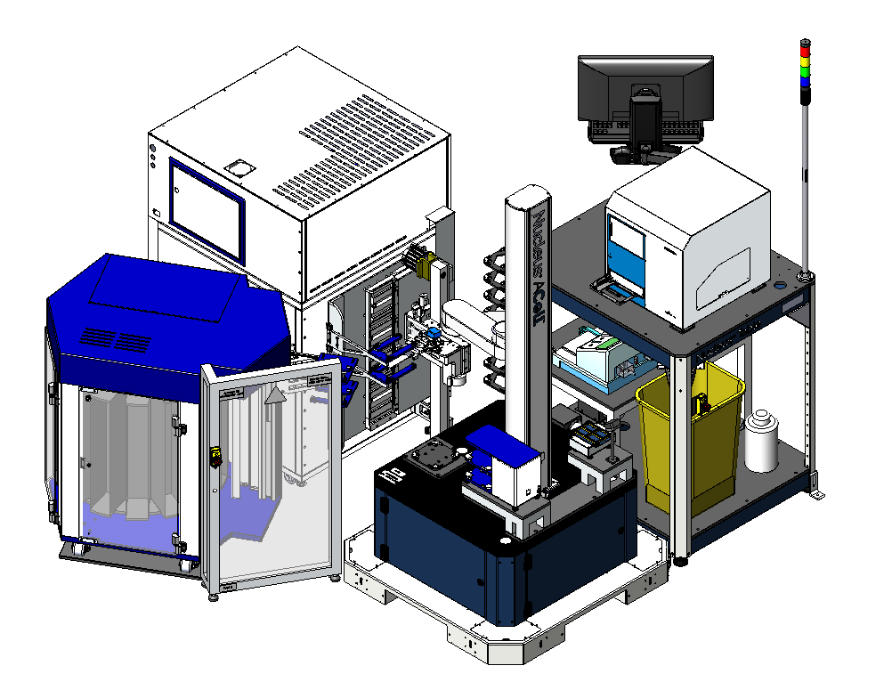
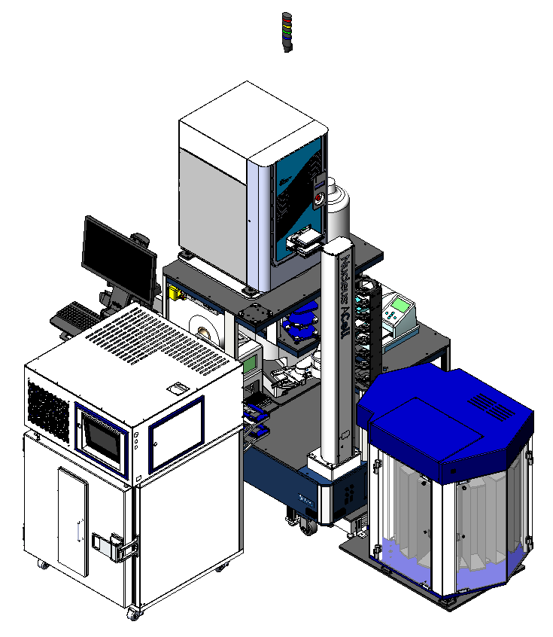
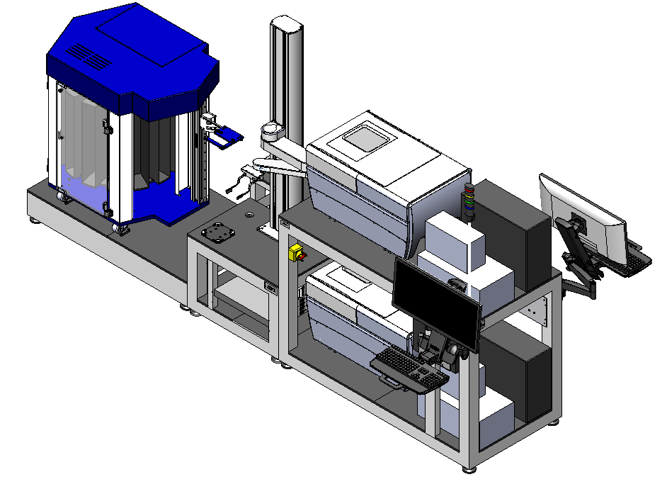

HighRes Automation in Platform Biology
Add-Mix-Read
Compound Printing
High Content Imaging
All systems:
UniFi web cameras for remote recovery and troubleshooting
Intentionally designed for future upgrades

Slide 10
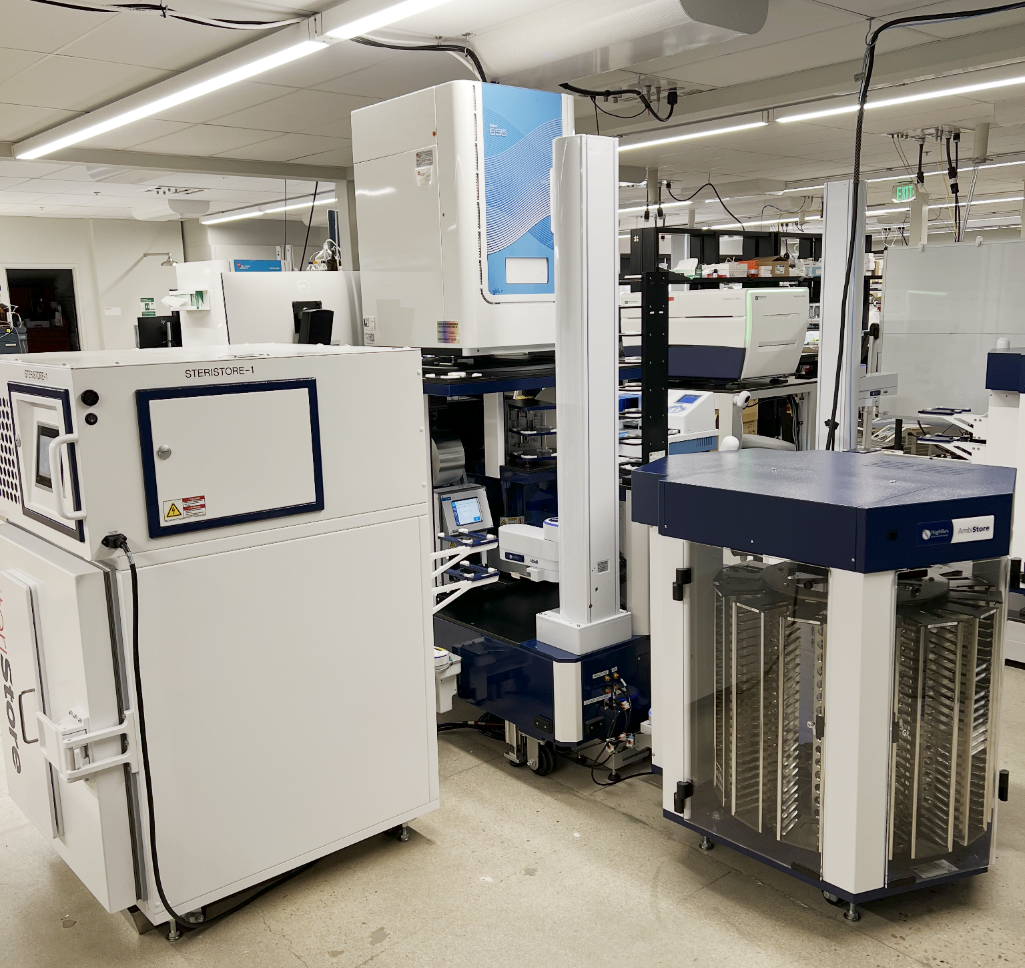
Compound Printing
MC1630
Dispense compounds and mixtures to assay plates via Echo
Devices:
  AmbiStore
  SteriStore (new!)
  PlateLoc
  XPeel
  LidValet
  Echo
  Multidrop Combi (new!)

Slide 11
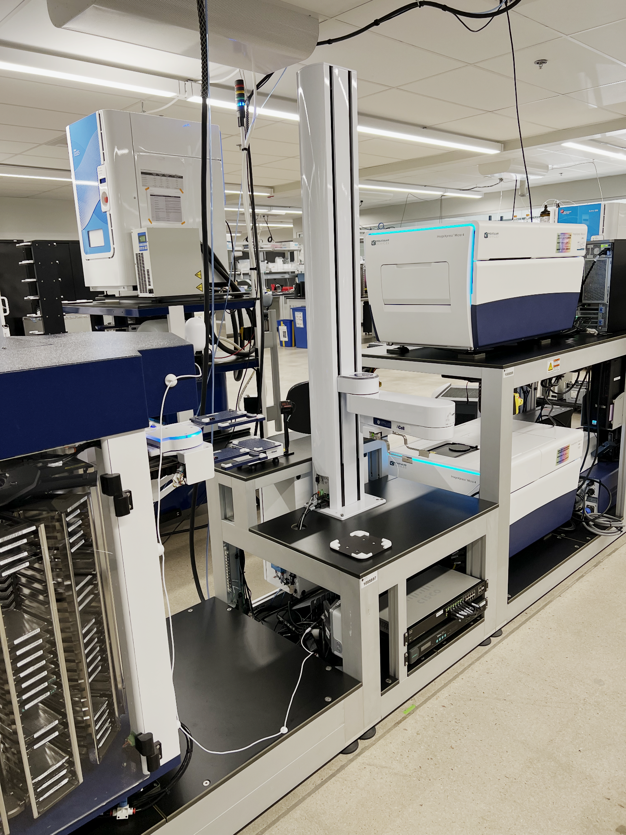
High Content Screening
MC1626
Load plates to high-content microscopes for imaging
Devices:
  AmbiStore
  PlateOrient
  ImageXpress Micro 4 (2X)

Slide 12
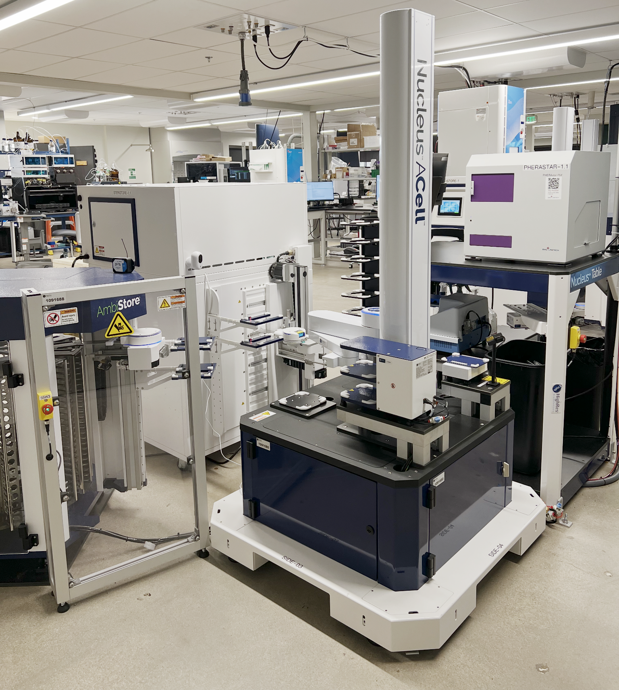
Add-Mix-Read
MC1709
Dispense reagent and read out plate-reader based assays
  Luminescence
  Fluorescence
  HTRF
  Absorbance
Devices:
  AmbiStore
  SteriStore
  PlateOrient
  LidValet
  LidDiscard
  Multidrop Combi
  Plate Reader

Slide 13

Conclusions
Enveda is translating nature’s chemistry to medicines
  Pure compound screening
  Semi-pure fraction screening
Automate low complexity, high-capacity tasks
  Wide variety of supported assays
  Mid to ultra HTS support
Small agile team, limited overhead
Flexible design for system upgrades
  Future proofing

Slide 14
Transforming Small Molecule Drug Discovery with Machine Learning & Metabolomics
We’re hiring, join our team!
enveda.com/careers

